Slide 1

SIGNALS and SYSTEMS
Dr. Ghasemian
Email: sghasemian68@gmail.com
Reference: Signals and systems, V. Oppenheim

Slide 2
Grading Policy:
Quiz and class work 25%
Midterm 30%
Project 10%
Final Exam 45%
Reference:
Signals and Systems by Oppenheim and Willsky

Slide 3
CHAPTER 1
SIGNALS and SYSTEMS

Slide 4
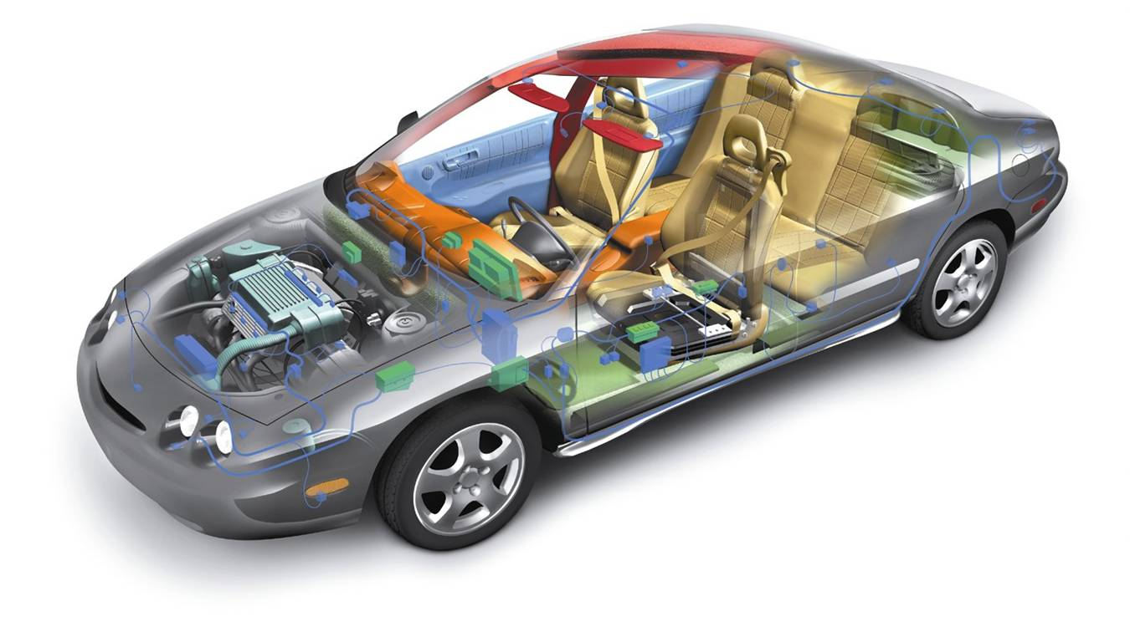
CHAPTER 1:SIGNALS and SYSTEMS
Signal and System definition
Signals, which are functions of one or more independent variables, contain information about the behavior or nature of some phenomenon. Voltages and currents as a function of time in an electrical circuit are examples of signals
Systems respond to particular signals by producing other signals or some desired behavior. A circuit is itself an example of a system.

Slide 5
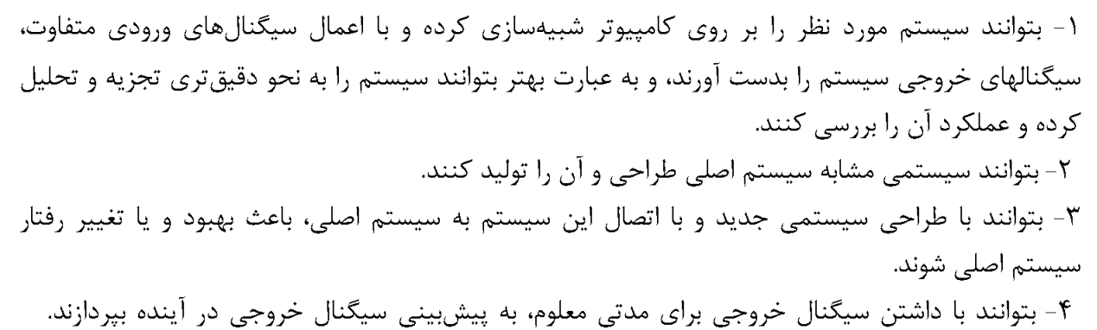
CHAPTER 1:SIGNALS and SYSTEMS
تعریف سیگنال: سیگنال بیانگر یک پدیده فیزیکی می باشد که خود آن تابعی از یک متغیر مستقل می باشد.
تعریف سیستم: یک مجموع منظم است که می تواند یک یا چند ورودی و خروجی داشته باشد.
اهداف:

Slide 6
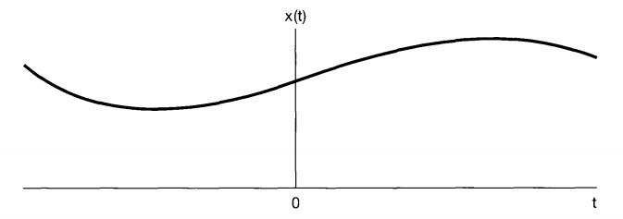
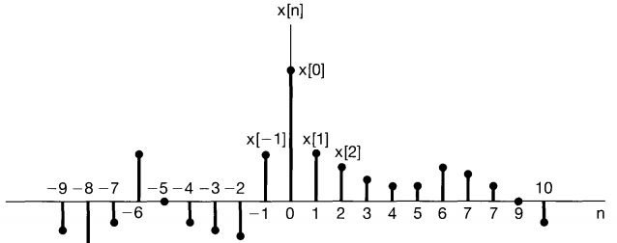
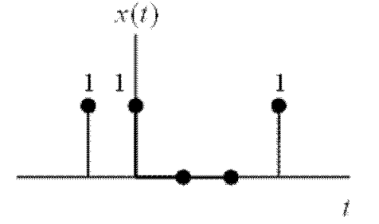
CHAPTER 1:SIGNALS and SYSTEMS
سیگنال پیوسته - Continuous
تقسیم بندی سیگنال ها:
سیگنال گسسته - Discrete
سیگنال دیجیتال - Digital

Slide 7
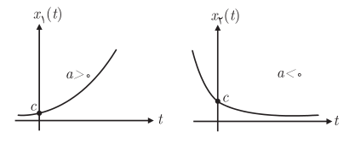
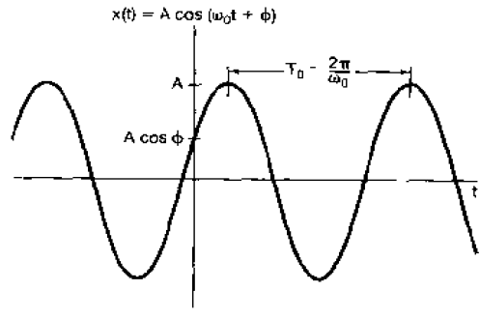
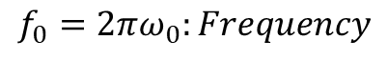
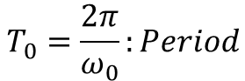
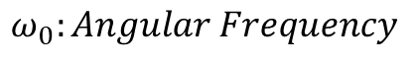
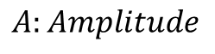
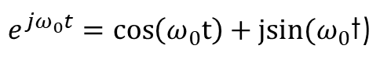
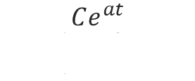
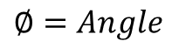
CHAPTER 1:SIGNALS and SYSTEMS
معرفی چند سیگنال مهم:
Real exponential signals
ddd
$$Ce^{at}$$
ddd
Sinusoidal signals
ddd
$$A:Amplitude$$
Imagine exponential signals
ddd
$$ω_{0}:Angular Frequency$$
$e^{jω_{0}t}=\cos\left(ω_{0}t\right)+jsin(ω_{0}$t)
$$T_{0}=\frac{2π}{ω_{0}}:Period$$
$$f_{0}=2πω_{0}:Frequency$$
$$∅=Angle$$

Slide 8
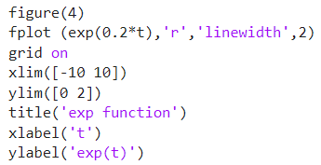
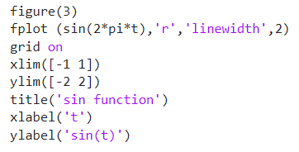
CHAPTER 1:SIGNALS and SYSTEMS
معرفی چند سیگنال مهم (MATLAB):
Real exponential signals
ddd
Sinusoidal signals
ddd

Slide 9
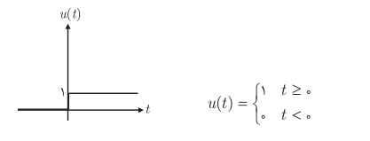
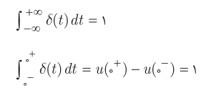
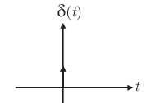
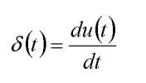
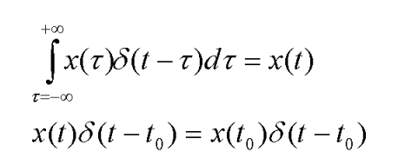
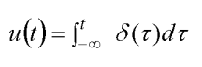
CHAPTER 1:SIGNALS and SYSTEMS
معرفی چند سیگنال مهم:
Unit time step signal
ddd
Direct delta signal
ddd

Slide 10
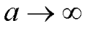
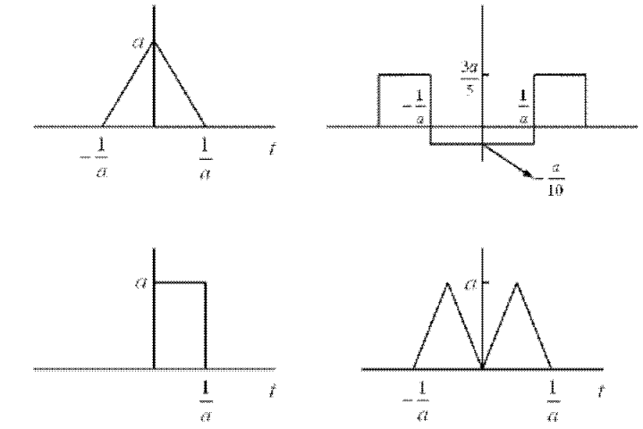
CHAPTER 1:SIGNALS and SYSTEMS
معرفی چند سیگنال مهم:
Direct delta signal
ddd

Slide 11
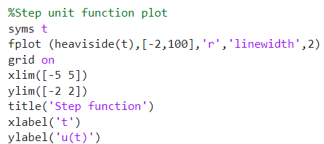
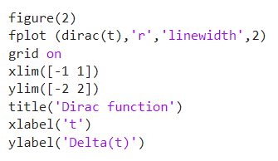
CHAPTER 1:SIGNALS and SYSTEMS
معرفی چند سیگنال مهم (MATLAB):
Unit time step signal
ddd
Direct delta signal
ddd

Slide 12
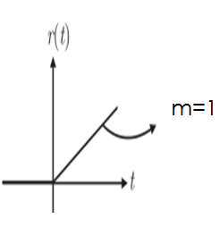
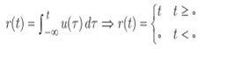
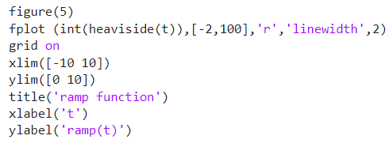
CHAPTER 1:SIGNALS and SYSTEMS
معرفی چند سیگنال مهم:
Ramp signal
ddd

Slide 13
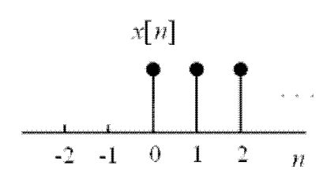
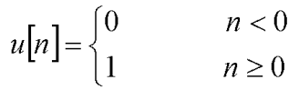
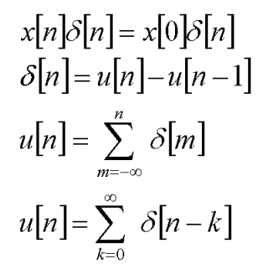
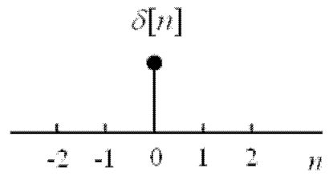
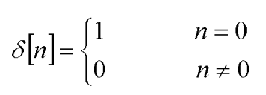
CHAPTER 1:SIGNALS and SYSTEMS
معرفی چند سیگنال گسسته مهم:
Unit time step signal
ddd
Direct delta signal
ddd

Slide 14
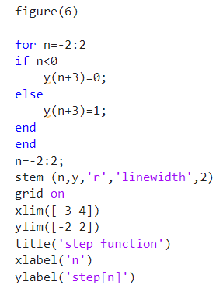
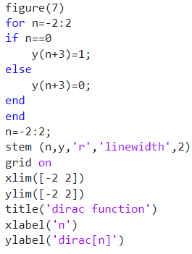
CHAPTER 1:SIGNALS and SYSTEMS
معرفی چند سیگنال گسسته مهم (MATLAB):
Unit time step signal
ddd
Direct delta signal
ddd

Slide 15
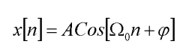
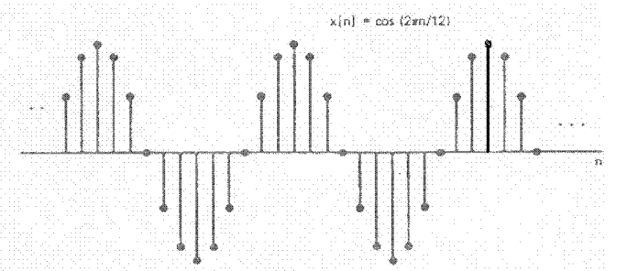
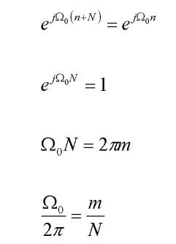
CHAPTER 1:SIGNALS and SYSTEMS
معرفی چند سیگنال گسسته مهم:

Slide 16
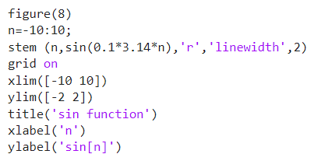
CHAPTER 1:SIGNALS and SYSTEMS
معرفی چند سیگنال گسسته مهم (MATLAB):

Slide 17
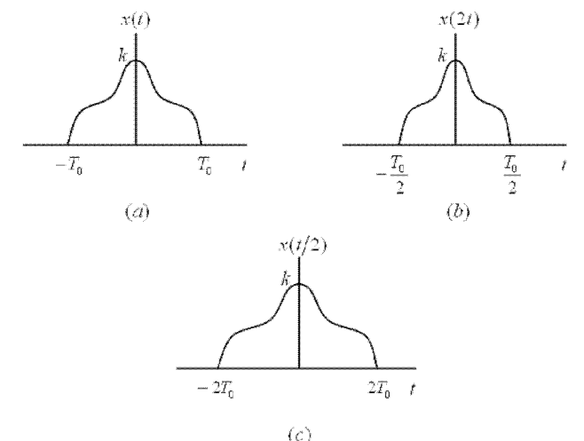
CHAPTER 1:SIGNALS and SYSTEMS
تبدیل متغیر مستقل
1- تغییر مقیاس (Scaling)

Slide 18
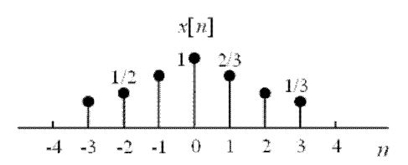
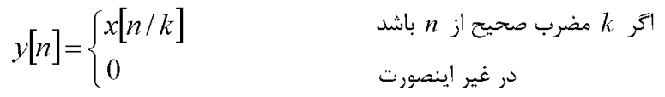
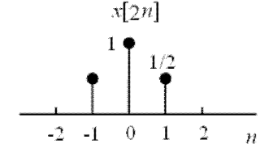
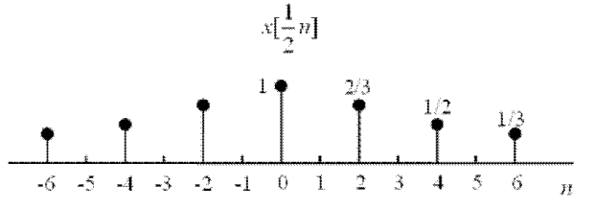
CHAPTER 1:SIGNALS and SYSTEMS
تبدیل متغیر مستقل
1- تغییر مقیاس (Scaling)

Slide 19
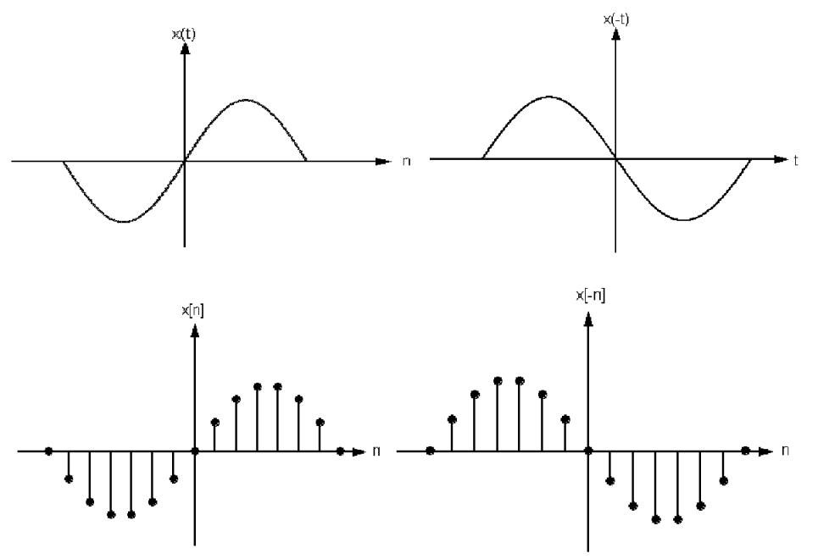
CHAPTER 1:SIGNALS and SYSTEMS
تبدیل متغیر مستقل
2- انعکاس (Reflection)

Slide 20
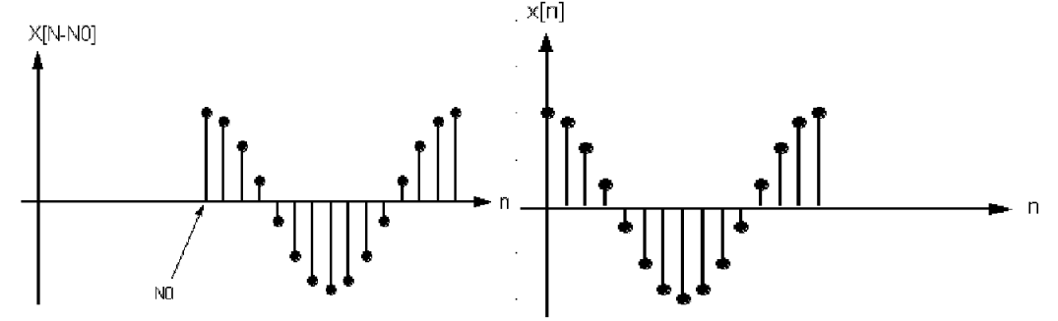
CHAPTER 1:SIGNALS and SYSTEMS
تبدیل متغیر مستقل
3- انتقال (Shift)

Slide 21
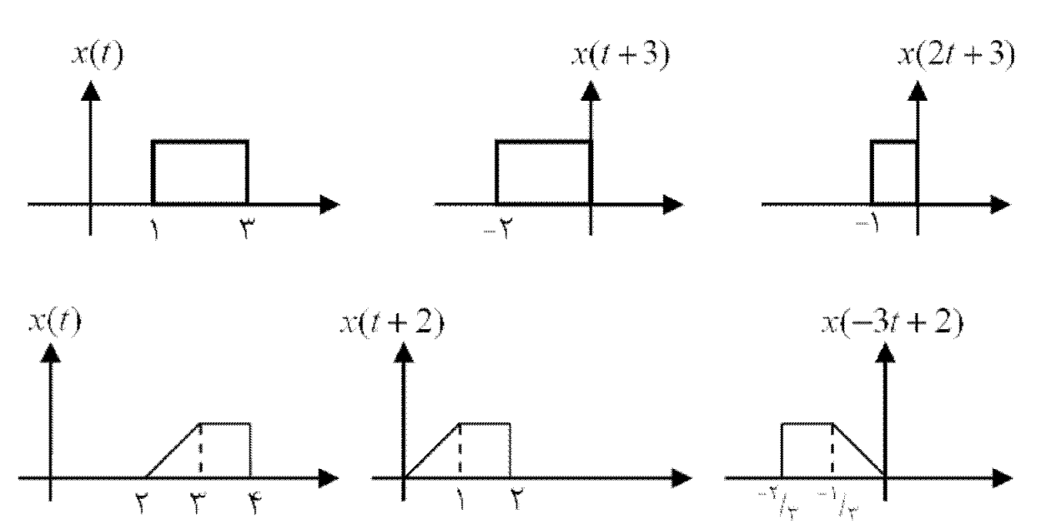
CHAPTER 1:SIGNALS and SYSTEMS
تبدیل متغیر مستقل
حالت کلی – x(at+b)

Slide 22
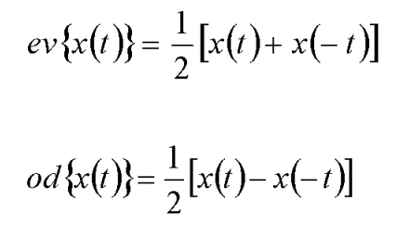
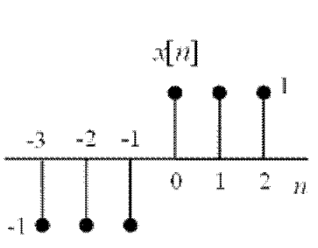




CHAPTER 1:SIGNALS and SYSTEMS
تعاریف در مورد سیگنال
سیگنال زوج و فرد
Even $(X(t)=X(−t))$
Odd $(X(t)=−X(−t))$ signals

Slide 23





CHAPTER 1:SIGNALS and SYSTEMS
تعاریف در مورد سیگنال
سیگنال متناوب
متناوب نیست
متناوب با دوره تناوب اصلی 6

Slide 24

CHAPTER 1:SIGNALS and SYSTEMS
تعاریف در مورد سیگنال
سایر:
Average : $<X\left(t\right)> =\lim_{T→∞}{\frac{1}{T}\int_{−0.5T}^{0.5T}{X\left(t\right)dt}}$
Root min square (rms) : $\sqrt{<X^{2}\left(t\right)>}$
ddd
Energy : $E_{x}=\int_{−∞}^{+∞}{{\left|x(t)\right|}^{2}}dt$
Power : $P_{x}=\lim_{T→∞}{\frac{1}{2T}}\int_{−T}^{+T}{{\left|x(t)\right|}^{2}}dt$

Slide 25





CHAPTER 1:SIGNALS and SYSTEMS
مثال
مثال

Slide 26






CHAPTER 1:SIGNALS and SYSTEMS
مثال
مثال

Slide 27






CHAPTER 1:SIGNALS and SYSTEMS
مثال
مثال

Slide 28



CHAPTER 1:SIGNALS and SYSTEMS
Example
Example- find the fundamental period (T) of the following signal (n$εZ):$
$$x\left(t\right)=\sum_{n=−∞}^{+∞}{e^{−\left|6t+n\right|}}$$
ddd
$$\sum_{n=−∞}^{+∞}{e^{−\left|6t+6T+n\right|}}=…+e^{−\left|6t+6T−2\right|}+e^{−\left|6t+6T−1\right|}+e^{−\left|6t+6T+0\right|}+e^{−\left|6t+6T+1\right|}+e^{−\left|6t+6T+2\right|}+…$$
$X(t+T)=X(t)$
$X(t+T)$= $\sum_{n=−∞}^{+∞}{e^{−\left|6t+6T+n\right|}}$
Periodic condition $→6T ε Z →6T=1$
$$T=\frac{1}{6}$$
$$\sum_{n=−∞}^{+∞}{e^{−\left|6t+n\right|}}=…+e^{−\left|6t−2\right|}+e^{−\left|6t−1\right|}+e^{−\left|6t+0\right|}+e^{−\left|6t+1\right|}+e^{−\left|6t+2\right|}+…$$

Slide 29



CHAPTER 1:SIGNALS and SYSTEMS
Example
Example- find energy and power of following signals$:$
a.) $x[n]=\frac{1}{\sqrt{n^{2}−n}}u[n−2]$
ddd
$E_{x}=\sum_{n=−∞}^{+∞}{x^{2}\left[n\right]=\sum_{n=−∞}^{+∞}{{\left[\frac{1}{\sqrt{n^{2}−n}}u[n−2] \right]}^{2}}}$
$$E_{x}=\sum_{n=2}^{+∞}{\frac{1}{n^{2}−n}=}\sum_{n=2}^{+∞}{\frac{1}{n−1}−\sum_{n=2}^{+∞}{\frac{1}{n}=}}\sum_{k=1}^{+∞}{\frac{1}{k}−\sum_{n=2}^{+∞}{\frac{1}{n}=}1+}\sum_{k=2}^{+∞}{\frac{1}{k}−\sum_{n=2}^{+∞}{\frac{1}{n}=1}}$$

Slide 30





CHAPTER 1:SIGNALS and SYSTEMS
Example
Example- find energy and power of following signals$:$
a.) $x[n]=\frac{1}{\sqrt{n^{2}−n}}u[n−2]$
ddd
$P_{x}=\lim_{N→∞}{\frac{1}{2N+1}}\sum_{n=−N}^{N}{x^{2}\left[n\right]=}$ $\lim_{N→∞}{\frac{1}{2N+1}}\sum_{n=−N}^{N}{{\left[\frac{1}{\sqrt{n^{2}−n}}u[n−2] \right]}^{2}}$
$P_{x}=$ $\lim_{N→∞}{\frac{1}{2N+1}}\left[\sum_{n=2}^{+∞}{\frac{1}{n^{2}−n}}\right]$ = $\lim_{N→∞}{\frac{1}{2N+1}}\left[\sum_{n=2}^{N}{\frac{1}{n−1}−\sum_{n=2}^{N}{\frac{1}{n}}}\right]$
$P_{x}=$ $\lim_{N→∞}{\frac{1}{2N+1}}\left[\sum_{k=1}^{N−1}{\frac{1}{k}−\sum_{n=2}^{N}{\frac{1}{n}}}\right]== \lim_{N→∞}{\frac{1}{2N+1}}\left[1+\sum_{k=2}^{N−1}{\frac{1}{k}−\sum_{n=2}^{N−1}{\frac{1}{n}−\frac{1}{N}}}\right]$
$P_{x}=$ $\lim_{N→∞}{\frac{1}{2N+1}}\left[1−\frac{1}{N}\right]$=0
$Finite energy$
$Zero power$

Slide 31




CHAPTER 1:SIGNALS and SYSTEMS
Example
Example- find energy and power of following signals$:$
b.) $x\left(t\right)=1+e^{−\frac{1}{3}\left|t\right|}$
ddd
$E_{x}=\int_{−∞}^{+∞}{{\left|1+e^{−\frac{1}{3}\left|t\right|}\right|}^{2}dt=\int_{−∞}^{+∞}{\left(1+e^{−\frac{2}{3}\left|t\right|}+2e^{−\frac{1}{3}\left|t\right|}\right)dt}}$
$$E_{x}=\int_{−∞}^{+∞}{1dt+\int_{−∞}^{+∞}{\left(e^{−\frac{2}{3}\left|t\right|}+2e^{−\frac{1}{3}\left|t\right|}\right)dt=∞}}$$
$$∞$$

Slide 32





CHAPTER 1:SIGNALS and SYSTEMS
Example
Example- find energy and power of following signals$:$
b.) $x\left(t\right)=1+e^{−\frac{1}{3}\left|t\right|}$
ddd
$P_{x}=\lim_{T→∞}{\frac{1}{2T}}\int_{−T}^{+T}{\left(1+e^{−\frac{2}{3}\left|t\right|}+2e^{−\frac{1}{3}\left|t\right|}\right)dt}$
$$P_{x}=\lim_{T→∞}{\frac{1}{2T}\left[\int_{−T}^{+T}{\left(1\right)dt}+\int_{−T}^{+T}{\left(e^{−\frac{2}{3}\left|t\right|}\right)dt}+\int_{−T}^{+T}{\left(2e^{−\frac{1}{3}\left|t\right|}\right)dt}\right]}$$
$P_{x}=\lim_{T→∞}{\frac{1}{2T}\left[2T+3\left(1−e^{−\frac{2}{3}T}\right)+12\left(1−e^{−\frac{1}{3}T}\right)\right]}$=1
$Finite power$
Infinite $energy$

Slide 33


CHAPTER 1:SIGNALS and SYSTEMS
Systems
T
S$ystem difinition:\text{A} \text{system} \text{is} \text{any} \text{process} \text{that} \text{produces} \text{an} \text{output} \text{signal} \text{in} \text{response} \text{to} \text{an} \text{input} \text{signal}\text{.}$
ddd
x: input signal or excitation
y: output signal or system response
T
T: transfer or transform function
y=T[x]

Slide 34





CHAPTER 1:SIGNALS and SYSTEMS
Systems
S$ystem example:$
ddd
I: input signal
$$\frac{V}{I}=R=T$$
V=RI
V: output signal
$$I$$
$$V$$
$$R$$

Slide 35






CHAPTER 1:SIGNALS and SYSTEMS
Systems
S$ystem example:$
ddd
Capacitor
ddd
i: output signal
$$i_{c}\left(t\right)=C\frac{dv_{c}(t)}{dt}$$
$$v_{c}(t)$$
$$i_{c}\left(t\right)$$
Differentiator
v: input signal
Inductor
ddd
i: output signal
$$i_{L}\left(t\right)=\frac{1}{L}\int{v_{L}\left(t\right)dt}$$
$$v_{L}(t)$$
Integrator
$$i_{L}\left(t\right)$$
v: input signal

Slide 36






CHAPTER 1:SIGNALS and SYSTEMS
Systems
I$nterconnections of systems:$
ddd
Series or Cascade
$$T=S1×S2$$
$$T=S1+S2$$
Parallel
$$T=S1−S2$$

Slide 37







CHAPTER 1:SIGNALS and SYSTEMS
Systems
I$nterconnections of systems:$
ddd
Series-Parallel
$$T=S6.\left[S1.\left(S2+S3\right)+S4.S5\right]$$
$$x(t)−S2.y(t)$$
$$\left(x\left(t\right)−S2.y\left(t\right)\right).S2$$
Feedback
$$T=\frac{S1}{1+S1S2}$$
$$S2.y(t)$$

Slide 38












CHAPTER 1:SIGNALS and SYSTEMS
Systems
Example$:Find block diagram of following circuit:$
ddd
$$V_{i}\left(t\right)$$
$$V_{o}\left(t\right)$$
$V_{o}(t)$: output signal
$$L\frac{di(t)}{dt}$$
$V_{i}(t)$: input signal
$$i(t)$$
$$L\frac{di(t)}{dt}$$
$$\frac{V_{o}\left(t\right)}{R}$$
$$V_{o}\left(t\right)=V_{i}\left(t\right)−L\frac{di(t)}{dt}$$
$$V_{o}\left(t\right)=V_{i}\left(t\right)−V_{L}\left(t\right)$$
$$i\left(t\right)=\frac{V_{o}(t)}{R}$$

Slide 39

CHAPTER 1:SIGNALS and SYSTEMS
Systems
Basic System properties$:$
ddd
System with or without memory
Time invariant and time dependent system
Stable or unstable system
Linear or non-linear system
Invertible system
Causal system
ddd

Slide 40






CHAPTER 1:SIGNALS and SYSTEMS
Systems
System with or without memory : A system is said memoryless if its output for each value of independent variable at a given time is depended on the input at the same time.
ddd
Without memory
With memory
$$y\left[n\right]=2\left[x\left[n\right]+x^{2}[n]\right]$$
$$y(t)=x(t−1)$$
$$y(t)=\frac{dx(t)}{dt}$$
$$y(t)=x^{2} (\frac{t}{2})$$
$$y[n]=\sum_{k=−∞}^{n}{x[k]}$$
$$y(t)=x(t)\cos^{2}(t−1)$$

Slide 41








CHAPTER 1:SIGNALS and SYSTEMS
Systems
Time invariant and time dependent system: A system is said invariant if the behavior of the system are fixed over the time.
ddd
$$x(t−t_{0})$$
invariant system
$$y(t−t_{0})$$
$y\left(t\right)=\sin\left(t\right).x(t)$
System response
variant system
$$x(t−t_{0})$$
$\sin\left(t\right).x(t−t_{0})≠y(t−t_{0}$)
$y\left(t\right)=\sin\left(x(t) \right)$
System response
Invariant system
$$x(t−t_{0})$$
$\sin\left(x(t−t_{0})\right)=y(t−t_{0}$)

Slide 42





CHAPTER 1:SIGNALS and SYSTEMS
Systems
Stable or unstable system: A stable system produced bounded output for the bounded input (BIBO).
ddd
$$∀t:\left|x(t)\right|≤M$$
stable system
$$\left|y(t)\right|≤K$$
stable system
$y\left[n\right]=x\left[n^{2}+1\right]+2cos⁡(x\left[n−3\right])$
$y\left[n\right]=\sum_{k=−∞}^{n}{x[k]}$
unstable system
X[n]=u[n]
y[n]=(n+1)u[n]
$$n→∞, y→∞$$

Slide 43






CHAPTER 1:SIGNALS and SYSTEMS
Systems
Linear or non-linear system: A linear system is a system that possesses the important property of superposition.
ddd
$$x_{1}\left(t\right)+x_{2}\left(t\right)$$
additivity
$$y_{1}\left(t\right)+y_{2}\left(t\right)$$
$${ax}_{1}\left(t\right)$$
homogenous
$${ay}_{1}\left(t\right)$$
$$a_{1}x_{1}\left(t\right)+{a_{2}x}_{2}\left(t\right)$$
linear
$${a_{1}y}_{1}\left(t\right)+{a_{2}y}_{2}\left(t\right)$$

Slide 44




CHAPTER 1:SIGNALS and SYSTEMS
Systems
Linear or non-linear system: ddd
$y(t)=cos⁡(t)x(t)$
Input: $a_{1}x_{1}\left(t\right)+{a_{2}x}_{2}\left(t\right)$
Output: $a_{1}{cos⁡(t)x}_{1}\left(t\right)+{a_{2}cos⁡(t)x}_{2}\left(t\right)$=$a_{1}y_{1}\left(t\right)+{a_{2}y}_{2}\left(t\right)$
linear
$y(t)=cos⁡(x(t))$
Input: $a_{1}x_{1}\left(t\right)+{a_{2}x}_{2}\left(t\right)$
Output: cos($a_{1}x_{1}$(t)+$a_{2}x_{2}$(t))$≠a_{1}y_{1}\left(t\right)+{a_{2}y}_{2}\left(t\right)$
Non-linear

Slide 45




CHAPTER 1:SIGNALS and SYSTEMS
Systems
Invertible system: a system is said to be invertible if distinct inputs lead to distinct outputs. ddd
$y(t)=2x(t)$
Invertible
Inverse:$w\left(t\right)=\frac{x(t)}{2}$
$y(t)=x^{2}(t)$
Non-invertible

Slide 46


CHAPTER 1:SIGNALS and SYSTEMS
Systems
Causal system: a system is causal if the output at any time depends on the input at the present time and in the past.
$y\left[n\right]=\sum_{k=−∞}^{n}{x[k]}$
Causal
$y(t)=x(t+1)$
Not Causal

Slide 47


CHAPTER 1:SIGNALS and SYSTEMS
Systems
Example: express basic properties of following system:
$y(t)=e^{x(t)}$
Without memory
Input: $x\left(t−t_{0}\right)→output:e^{x(t−t0)}=y\left(t−t_{0}\right)$ time invariant
$∀t:\left|x\left(t\right)\right|≤M→output:\left|y\left(t\right)\right|=\left|e^{x\left(t\right)}\right|≤K$ stable
Input: $a_{1}x_{1}\left(t\right)+{a_{2}x}_{2}\left(t\right)→output:e^{a_{1}x_{1}\left(t\right)+{a_{2}x}_{2}\left(t\right)}≠{a_{1}y}_{1}\left(t\right)+{a_{2}y}_{2}\left(t\right)$ non-linear
Invertible $→ln⁡(x\left(t\right))$
Causal

Slide 48











CHAPTER 1:SIGNALS and SYSTEMS
Systems
Example: consider a LTI system whose response to the signal $x_{1}\left(t\right)$ is $y_{1}\left(t\right)$. Find response of this system to $x_{2}\left(t\right)$.is
$$x_{2}\left(t\right)$$
$$x_{2}\left(t\right)=x_{1}\left(t\right)−x_{1}\left(t−2\right)$$
$$x_{1}\left(t\right)$$
system
$$y_{1}\left(t\right)$$
$$x_{1}\left(t\right)−x_{1}\left(t−2\right)$$
$y_{1}\left(t\right)$-$y_{1}\left(t−2\right)$
LTI system
$$x_{1}\left(t−2\right)$$
TI system
$$y_{1}\left(t−2\right)$$

Slide 49

CHAPTER 1:SIGNALS and SYSTEMS
Systems
Example: consider a LTI system whose response to the signal $x_{1}\left(t\right)$ is $y_{1}\left(t\right)$. Find response of this system to $x_{2}\left(t\right)$.is
$$x_{2}\left(t\right)$$

Slide 50





CHAPTER 1:SIGNALS and SYSTEMS
Systems
Example: determine if each of the following system is invertible. If it is, find the inverse system.
$y(t)=x(t+4)$
$$Invertible→y\left(t\right)=x(t−4)$$
$y(t)=cos⁡[x\left(t\right)]$
$$non−Invertible→x_{1}\left(t\right)=0,x_{2}\left(t\right)=2π, y\left(t\right)=1$$
$y[n]=nx[n]$
$non−Invertible→x_{1}\left(t\right)=δ\left[n\right]→y\left[n\right]=nδ\left[n\right]=0 ,x_{2}\left(t\right)=nδ\left[n\right] → ,y[n]=n^{2}δ\left[n\right]$=0

Slide 51








CHAPTER 1:SIGNALS and SYSTEMS
Systems
Example: Find relationship between output and input of following system:
Delay for 1sec
$$z\left(t\right)=x(t−1)$$
$with memory$
Time invariant
Stable
Non-linear
Not-invertible
causal
$$w\left(t\right)=x^{2} (t−1)$$
$$y\left(t\right)=\left|x\left(t\right)−x(t−1)\right|$$
$$g\left(t\right)=2\left(x\left(t\right)+z(t)\right)$$
$$v\left(t\right)=x^{2} (t)$$
$$y\left(t\right)=\sqrt{w\left(t\right)+v\left(t\right)−g(t)}$$

Slide 52










CHAPTER 1:SIGNALS and SYSTEMS
Systems
Example: consider following feedback system and assume that y[n]=0 for n<0. find system response to $δ\left[n\right] and u\left[n\right].$is
$$e\left[n\right]=x\left[n\right]−y[n]$$
$$y\left[n\right]=e\left[n−1\right]=x\left[n−1\right]−y[n−1]$$
$x[n]=δ[n]$
$$y[n]$$
$$y\left[0\right]=x\left[−1\right]−y\left[−1\right]=0$$
$$y\left[1\right]=x\left[0\right]−y\left[0\right]=1$$
$$y\left[2\right]=x\left[1\right]−y\left[1\right]=−1$$
$$y\left[3\right]=x\left[2\right]−y\left[2\right]=1$$
$$y\left[4\right]=x\left[3\right]−y\left[3\right]=−1$$

Slide 53



CHAPTER 1:SIGNALS and SYSTEMS
Systems
Example: consider following feedback system and assume that y[n]=0 for n<0. find system response to $δ\left[n\right] and u\left[n\right].$is
$$e\left[n\right]=x\left[n\right]−y[n]$$
$$y\left[n\right]=e\left[n−1\right]=x\left[n−1\right]−y[n−1]$$
$x[n]=u[n]$
$$y[n]$$
$$y\left[0\right]=x\left[−1\right]−y\left[−1\right]=0$$
$$y\left[1\right]=x\left[0\right]−y\left[0\right]=1$$
$$y\left[2\right]=x\left[1\right]−y\left[1\right]=0$$
$$y\left[3\right]=x\left[2\right]−y\left[2\right]=1$$
$$y\left[4\right]=x\left[3\right]−y\left[3\right]=0$$

Slide 54


CHAPTER 1:SIGNALS and SYSTEMS
Systems
Example: express basic properties of following system:
$y(t)=\frac{x^{3}\left(t\right)−x\left(t\right)+1}{t^{2}+4}$
Without memory
Input: $x\left(t−t_{0}\right)→output:\frac{x^{3}\left(t−t_{0}\right)−x\left(t−t_{0}\right)+1}{t^{2}+4}≠y\left(t−t_{0}\right)$ time variant
$∀t:\left|x\left(t\right)\right|≤M→output:\left|y\left(t\right)\right|≤K$ stable
Input: $a_{1}x_{1}\left(t\right)+{a_{2}x}_{2}\left(t\right)→output:\frac{{\left(a_{1}x_{1}\left(t\right)+{a_{2}x}_{2}\left(t\right)\right)}^{3}−\left(a_{1}x_{1}\left(t\right)+{a_{2}x}_{2}\left(t\right)\right)+1}{t^{2}+4}≠{a_{1}y}_{1}\left(t\right)+{a_{2}y}_{2}\left(t\right)$ non-linear
Non-Invertible $→x\left(t\right)=1, x\left(t\right)=−1,y(t)=\frac{1}{t^{2}+4}$
Causal

Slide 55
CHAPTER 2
TIME DOMAIN ANALYSIS OF LINEAR TIME-INVARIANT (LTI) SYSTEM

Slide 56






CHAPTER 2:TIME DOMAIN ANALYSIS OF LTI SYSTEM
additivity
LTI system:
Linear system
LTI system
homogenous
Time invariant system
Number of input and output :
$$x[n]$$
$$y[n]$$
$$x_{1}[n]$$
$$y_{1}[n]$$
SISO
MIMO
$$x_{m}[n]$$
$$y_{k}[n]$$

Slide 57








CHAPTER 2:TIME DOMAIN ANALYSIS OF LTI SYSTEM
LTI system response to each input signal, base on the impulse system response.
$$δ[n]$$
LTI system
$$h[n]$$
The representation of discrete-time signals in term of impulses:
$$x[n]$$
$$x[n]=\sum_{k=−∞}^{+∞}{x\left[k\right]δ\left[n−k\right]}$$
$$x\left[1\right]δ[n−1]$$
$$x\left[2\right]δ[n−2]$$
$$x\left[3\right]δ[n−3]$$
$x[n]=x\left[1\right]δ[n−1]$+$x\left[2\right]δ\left[n−2\right]+x\left[3\right]δ[n−3]$

Slide 58




CHAPTER 2:TIME DOMAIN ANALYSIS OF LTI SYSTEM
LTI system response to each input signal, base on the impulse system response.
LTI System response to x[n]:
homogenous
additivity

Slide 59



CHAPTER 2:TIME DOMAIN ANALYSIS OF LTI SYSTEM
LTI system response to each input signal, base on the impulse system response.
LTI System response to x[n]:
Linear system
$$y[n]=\sum_{k=−∞}^{+∞}{x\left[k\right]h_{k}[n]}$$
$$x[n]$$
Time invariant
$h_{k}[n]$=$h_{0}[n−k]$

Slide 60


CHAPTER 2:TIME DOMAIN ANALYSIS OF LTI SYSTEM
LTI system response to each input signal, base on the impulse system response.
LTI System response to x[n]:
$$y[n]=\sum_{k=−∞}^{+∞}{x\left[k\right]h_{0}[n−k]}$$
$$x[n]$$
LTI System
Convolution sum
$$y\left[n\right]=x\left[n\right]∗h_{0}\left[n\right]=\sum_{k=−∞}^{+∞}{x\left[k\right]h_{0}[n−k]}$$

Slide 61


CHAPTER 2:TIME DOMAIN ANALYSIS OF LTI SYSTEM
Example: Considerer a system with impulse response h[n]. Find response to the input signal x[n].
$$y\left[n\right]=x\left[n\right]∗h\left[n\right]=\sum_{k=−∞}^{+∞}{x\left[k\right]h\left[n−k\right]}=x\left[0\right]h\left[n\right]+x\left[1\right]h\left[n−1\right]=0.5h\left[n\right]+2h[n−1]$$

Slide 62





CHAPTER 2:TIME DOMAIN ANALYSIS OF LTI SYSTEM
Example: Considerer a system with impulse response h[n]. Find response to the input signal x[n].
$$y\left[n\right]=x\left[n\right]∗h\left[n\right]=\sum_{k=−∞}^{+∞}{x\left[k\right]h\left[n−k\right]}=x\left[0\right]h\left[n\right]+x\left[1\right]h\left[n−1\right]=0.5h\left[n\right]+2h[n−1]$$

Slide 63




CHAPTER 2:TIME DOMAIN ANALYSIS OF LTI SYSTEM
Example: Considerer a system with impulse response h[n]. Find response to the input signal x[n].
$$x\left[n\right]=a^{n}u\left[n\right]$$
0<a<1
$$h\left[n\right]=u\left[n\right]$$
$y\left[n\right]=x\left[n\right]∗h\left[n\right]=\sum_{k=−∞}^{+∞}{x\left[k\right]h\left[n−k\right]}$=$\sum_{k=0}^{+∞}{a^{k}h\left[n−k\right]}$
$$n<0 →y\left[n\right]=0$$
$$n≥0 → y\left[n\right]=\sum_{k=0}^{n}{a^{k}}=\frac{1−a^{n+1}}{1−a}$$
$$y\left[n\right]=\frac{1−a^{n+1}}{1−a}u[n]$$

Slide 64





CHAPTER 2:TIME DOMAIN ANALYSIS OF LTI SYSTEM
Example: Considerer a system with impulse response h[n]. Find response to the input signal x[n]. (a>1)
$$x\left[n\right]=\left\{\begin{aligned}1 0≤n≤4 \\ 0 otherwise\end{aligned}\right.$$
$$h\left[n\right]=\left\{\begin{aligned}a^{n} 0≤n≤6 \\ 0 otherwise\end{aligned}\right.$$
$$y\left[n\right]=x\left[n\right]∗h\left[n\right]=\sum_{k=−∞}^{+∞}{x\left[k\right]h\left[n−k\right]}$$

Slide 65






CHAPTER 2:TIME DOMAIN ANALYSIS OF LTI SYSTEM
$$y\left[n\right]=0$$
$$y\left[n\right]=\sum_{k=0}^{n}{a^{n−k}}=\frac{1−a^{n+1}}{1−a}$$
$y\left[n\right]=\sum_{k=0}^{4}{a^{n−k}}=a^{n}\left(1+a^{−1}+a^{−2}+a^{−3}+a^{−4}\right)$=$a^{n}\frac{1−a^{−5}}{1−a^{−1}}$=$\frac{a^{n+1}−a^{n−4}}{a−1}$

Slide 66





CHAPTER 2:TIME DOMAIN ANALYSIS OF LTI SYSTEM
$$k=r+n−6$$
$$y\left[n\right]=\sum_{k=n−6}^{4}{a^{n−k}}=\sum_{r=0}^{10−n}{a^{6−r}}=a^{6}\frac{1−a^{n−11}}{1−a^{−1}}=\frac{a^{7}−a^{n−4}}{a−1}$$
$$y\left[n\right]=0$$

Slide 67



CHAPTER 2:TIME DOMAIN ANALYSIS OF LTI SYSTEM
LTI system response to each input signal, base on the impulse system response.
LTI System response to x(t):
$$y(t)=\int_{−∞}^{+∞}{x(}τ)h(t−τ)dτ$$
$$x(t)$$
LTI System
h(t) is unit impulse response
Convolution integral
$$y(t)=x(t)∗h(t)=\int_{−∞}^{+∞}{x(}τ)h(t−τ)dτ$$

Slide 68















CHAPTER 2:TIME DOMAIN ANALYSIS OF LTI SYSTEM
LTI system response to each input signal, base on the impulse system response.
Transformation of the independent variable: $τ$ in x$\left(τ\right) →x(t−τ)$
$$X(τ)$$
$$X(−τ)$$
$$X(t−τ)$$
$$τ$$
$$τ$$
$$τ$$
$$X(1−τ)$$
$$X(−1−τ)$$
$$−1−T$$
$$−1$$
$$τ$$
$$1−T$$
$$1$$
$$τ$$

Slide 69












CHAPTER 2:TIME DOMAIN ANALYSIS OF LTI SYSTEM
$$h(t)$$
Example: obtain the convolution of the following signals:
$$x(t)=\left\{\begin{aligned}1 0≤t≤T \\ 0 otherwise\end{aligned}\right.$$
$$h(t)=\left\{\begin{aligned}t 0≤t≤2T \\ 0 otherwise\end{aligned}\right.$$
$$2T$$
$$t$$
$$y(t)=x(t)∗h(t)=\int_{−∞}^{+∞}{x(}τ)h(t−τ)dτ$$
$$t<0$$
$$τ$$
$$τ$$
$$y(t)=0$$

Slide 70








CHAPTER 2:TIME DOMAIN ANALYSIS OF LTI SYSTEM
$$0<t<T$$
$$τ$$
$$y(t)=x(t)∗h(t)=\int_{0}^{t}{x(}τ)h(t−τ)dτ=\int_{0}^{t}{\left(t−τ\right)dτ=0.5}t^{2}$$
$$T<t<2T$$
$$τ$$
$$y(t)=x(t)∗h(t)=\int_{0}^{T}{x(}τ)h(t−τ)dτ=\int_{0}^{T}{\left(t−τ\right)dτ=}tT−0.5T^{2}$$

Slide 71





CHAPTER 2:TIME DOMAIN ANALYSIS OF LTI SYSTEM
$$2T<t<3T$$
$$τ$$
$$y(t)=x(t)∗h(t)=\int_{t−2T}^{T}{x(}τ)h(t−τ)dτ=\int_{t−2T}^{T}{\left(t−τ\right)dτ=−0.5}t^{2}+tT+1.5T^{2}$$
$$3T<t$$
$$τ$$
$$y(t)=0$$

Slide 72



CHAPTER 2:TIME DOMAIN ANALYSIS OF LTI SYSTEM
Convolution properties:
The commutative property:
$$x\left(t\right)∗h\left(t\right)=h\left(t\right)∗x(t)$$
The distributive property:
$$x\left(t\right)∗\left[h_{1}(t)+h_{2}(t)\right]=x\left(t\right)∗h_{1}(t)+x\left(t\right)∗h_{2}(t)$$
The associative property:
$$x\left(t\right)∗\left[h_{1}(t)∗h_{2}(t)\right]=\left[x\left(t\right)∗h_{1}(t)\right]∗h_{2}(t)$$
Convolution with impulse:
$x\left(t\right)∗ δ(t−t_{0})=x(t−t_{0}$)

Slide 73






CHAPTER 2:TIME DOMAIN ANALYSIS OF LTI SYSTEM
LTI system properties base on the impulse response:
LTI system with or without memory:
$$y\left[n\right]=\sum_{k=−∞}^{+∞}{x\left[k\right]h\left[n−k\right]}=…+x\left[n−1\right]h\left[n−\left(n−1\right)\right]+x\left[n\right]h\left[n−n\right]+x\left[n+1\right]h\left[n−\left(n+1\right)\right]+…$$
$$h[n]=0 for n≠0$$
$$h\left[n\right]=kδ[n]$$
$$y[n]=kx[n]$$
Invertibility of LTI system:
$$h\left[n\right]∗h_{1}[n]=δ[n]$$

Slide 74





CHAPTER 2:TIME DOMAIN ANALYSIS OF LTI SYSTEM
LTI system properties base on the impulse response:
Invertibility of LTI system (example):
$$y\left(t\right)=x(t−t_{0})$$
$$h\left(t\right)=δ(t−t_{0})$$
$$y\left(t\right)=x(t+t_{0})$$
$$h_{1}\left(t\right)=δ(t+t_{0})$$
$${h\left(t\right)∗h}_{1}\left(t\right)=δ(t)$$

Slide 75

CHAPTER 2:TIME DOMAIN ANALYSIS OF LTI SYSTEM
LTI system properties base on the impulse response:
Causality of LTI system :
$$y\left[n\right]=x\left[n\right]∗h\left[n\right]=\sum_{k=−∞}^{+∞}{x\left[k\right]h\left[n−k\right]}$$
$$Causality→for K>n:h\left[n−k\right]=0 or for n<0 h\left[n\right]=0$$
$h\left[n\right]=u\left[n\right]→causal system$
$h\left[n\right]=δ\left[n+1\right]→not causal system$

Slide 76







CHAPTER 2:TIME DOMAIN ANALYSIS OF LTI SYSTEM
LTI system properties base on the impulse response:
Stability of LTI system :
$$∀t:\left|x(t)\right|≤M$$
stable system
$$\left|y(t)\right|≤K$$
$$\left|y\left[n\right]\right|=\left|x\left[n\right]∗h\left[n\right]\right|=\left|\sum_{k=−∞}^{+∞}{x\left[k\right]h\left[n−k\right]}\right|=\left|\sum_{k=−∞}^{+∞}{x\left[n−k\right]h\left[k\right]}\right|$$
$$\left|y\left[n\right]\right|≤M\left|\sum_{k=−∞}^{+∞}{h\left[k\right]}\right|$$
$$system is stable if :\left|\sum_{k=−∞}^{+∞}{h\left[k\right]}\right|≤∞$$
$$h\left[n\right]=δ\left[n\right]→\left|\sum_{k=−∞}^{+∞}{h\left[k\right]}\right|=1 stable$$
$$h\left[n\right]=u\left[n\right]→\left|\sum_{k=−∞}^{+∞}{h\left[k\right]}\right|=∞ unstable$$

Slide 77




CHAPTER 2:TIME DOMAIN ANALYSIS OF LTI SYSTEM
LTI system properties base on the impulse response:
The unit time step response of LTI system :
$$S\left[n\right]=x\left[n\right]∗h\left[n\right]=u\left[n\right]∗h\left[n\right]=h\left[n\right]∗u[n]$$
$$S\left[n\right]=\sum_{k=−∞}^{+∞}{h\left[k\right]u\left[n−k\right]}=\sum_{k=−∞}^{n}{h\left[k\right]}=h\left[n\right]+\sum_{k=−∞}^{n−1}{h\left[k\right]}=h\left[n\right]+S[n−1]$$
$$h\left[n\right]=S\left[n\right]−S[n−1]$$
$$S(t)=\int_{−∞}^{t}{h\left(τ\right)dτ}$$
$$h(t)=\frac{dS(t)}{dt}$$

Slide 78


CHAPTER 2:TIME DOMAIN ANALYSIS OF LTI SYSTEM
Example
Example: Considerer a system with impulse response h[n]=(n+1)u[n+1]. Find response to the input signal x[n]=u[n]-u[n-2].
$$y\left[n\right]=x\left[n\right]∗h[n]$$
$$x\left[n\right]=δ\left[n\right]+δ\left[n−1\right]$$
$$y\left[n\right]=h\left[n\right]+h\left[n−1\right]=\left(n+1\right)u\left[n+1\right]+nu[n]$$
$$y\left[n\right]=\left\{\begin{aligned}0 n<0 \\ 2n+1 n≥0\end{aligned}\right.$$
$$y\left[n\right]=\left(2n+1\right)u(n)$$

Slide 79
CHAPTER 2:TIME DOMAIN ANALYSIS OF LTI SYSTEM
Example
Example: Find simple form of y(t)= x(2t)* $δ\left(4−2t\right).$
$$δ\left(4−2t\right)=δ(−2\left(t−2\right)=\frac{1}{\left|−2\right|}δ(t−2)$$
$$y\left(t\right)=x\left(2t\right)∗\frac{1}{2}δ\left(t−2\right)=\frac{1}{2}x(2t−4)$$

Slide 80
CHAPTER 2:TIME DOMAIN ANALYSIS OF LTI SYSTEM
Example: express basic properties (memory, causality, stability) of systems with following impulse response.
$e^{−t}u(t+1)$
$h\left(t\right)≠kδ\left(t\right)→with memory$
For t<0 : h(t) $≠0→not causal$
$\int_{−∞}^{+∞}{\left|h\left(t\right)\right|dt=\int_{−1}^{+∞}{e^{−t}dt=e^{−(−1)}−e^{−∞}=e →stable}}$
$\sum_{k=0}^{7}{sin(4π(t−\frac{k}{8})})$
$sin⁡(4πt)+\sin\left(4πt−\frac{π}{2}\right)+\sin\left(4πt−\frac{π}{1}\right)+\sin\left(4πt−\frac{3π}{2}\right)+sin⁡(4πt−\frac{4π}{2})$+$\sin\left(4πt−\frac{5π}{2}\right)+\sin\left(4πt−\frac{6π}{2}\right)+\sin\left(4πt−\frac{7π}{2}\right)=0$
$without memory$
$causal$
$stable$

Slide 81


CHAPTER 2:TIME DOMAIN ANALYSIS OF LTI SYSTEM
Example: express basic properties (memory, causality, stability) of systems with following unit time step response.
$h\left(t\right)≠kδ\left(t\right)→with memory$
For t<0 : h(t) $≠0→not causal$
$\int_{−∞}^{+∞}{\left|h\left(t\right)\right|dt=\int_{−∞}^{+∞}{δ\left(t+2\right)dt}}+\int_{−∞}^{+∞}{δ\left(t\right)dt}$+$\int_{−∞}^{+∞}{δ\left(t−1\right)dt}$+$\int_{−∞}^{+∞}{δ\left(t−2\right)dt}+\int_{−∞}^{+∞}{\left(u\left(t\right)−u\left(t−2\right)\right)dt=1+1+1+1+2=7 →stable}$

Slide 82



CHAPTER 2:TIME DOMAIN ANALYSIS OF LTI SYSTEM
Parallel
$$h(t)=\sum_{k=1}^{n}{h_{k}(t)}$$
Series
$$h\left(t\right)=h_{1}\left(t\right)∗h_{2}\left(t\right)∗…∗h_{n}(t)$$
Feedback
$$y\left(t\right)∗[δ\left(t\right)+h_{1}\left(t\right)∗h_{2}\left(t\right)]=x(t)∗h_{2}\left(t\right)$$

Slide 83



CHAPTER 2:TIME DOMAIN ANALYSIS OF LTI SYSTEM
Example: Considerer systems T1 and T2 with unit time step responses S1 and S2. Find T response to the impulse signal.
$$h\left(t\right)=h_{1}\left(t\right)∗h_{2}\left(t\right)$$
1
-1
1
3
-1
$$h_{2}\left(t\right)=u\left(t+1\right)−2u\left(t−1\right)+u(t−3)$$
$$h_{1}\left(t\right)=δ\left(t\right)−δ\left(t−2\right)$$

Slide 84
CHAPTER 2:TIME DOMAIN ANALYSIS OF LTI SYSTEM
Example: Considerer systems T1 and T2 with unit time step responses S1 and S2. Find T response to the impulse signal.
$$h\left(t\right)=h_{1}\left(t\right)∗h_{2}\left(t\right)$$
$$h_{1}\left(t\right)=δ\left(t\right)−δ\left(t−2\right)$$
$$h_{2}\left(t\right)=u\left(t+1\right)−2u\left(t−1\right)+u(t−3)$$
$$h\left(t\right)=h_{1}\left(t\right)∗h_{2}\left(t\right)=u\left(t+1\right)−2u\left(t−1\right)+u\left(t−3\right)−u\left(t−1\right)+2u\left(t−3\right)−u(t−5)$$
$$h\left(t\right)=h_{1}\left(t\right)∗h_{2}\left(t\right)=u\left(t+1\right)−3u\left(t−1\right)+3u\left(t−3\right)−u(t−5)$$

Slide 85
CHAPTER 3
FREQUENCY DOMAIN ANALYSIS OF (LTI) SYSTEM – THE CONTINOUS TIME FOURIER TRANSFORMER

Slide 86

CHAPTER 3:FREQUENCY DOMAIN ANALYSIS OF LTI SYSTEM
Signal space:
Energy and power signal:
$$Energy signal$$
$$Power signal$$
$All periodic signals are power signal.$
All energy signals are non-periodic.

Slide 87

CHAPTER 3:FREQUENCY DOMAIN ANALYSIS OF LTI SYSTEM
Signal space:
Energy and power signal:
Energy
Power
Type
Signal
Energy
Energy
Power
Power
No power- No Energy

Slide 88
CHAPTER 3:FREQUENCY DOMAIN ANALYSIS OF LTI SYSTEM
Signal space:
Inner product:
$$<v\left(t\right), w\left(t\right)> = \lim_{T→∞}{\int_{−0.5T}^{0.5T}{v\left(t\right)w^{∗}\left(t\right)dt}}$$
Energy signal
Similarity of two signals
$$<v\left(t\right), w\left(t\right)> = \lim_{T→∞}{\frac{1}{T}\int_{−0.5T}^{0.5T}{v\left(t\right)w^{∗}\left(t\right)dt}}$$
Power signal
$$<v\left(t\right), w\left(t\right)> =0$$
$$Orthogonal signals$$
$v(t)$ is more similar to $w_{1}(t)$ if:
$$\left(<v\left(t\right), w_{1}\left(t\right)>\right)>\left(<v\left(t\right), w_{2}\left(t\right)>\right)$$

Slide 89


CHAPTER 3:FREQUENCY DOMAIN ANALYSIS OF LTI SYSTEM
Signal space:
Example: Which of the following signals is more similar to x(t):
$$<x\left(t\right)∗v_{1}\left(t\right)> =\lim_{T→∞}{\int_{−0.5T}^{0.5T}{x\left(t\right)v_{1}\left(t\right)dt}}=\frac{\sqrt{3}}{3}$$
$$<x\left(t\right)∗v_{2}\left(t\right)> =\lim_{T→∞}{\int_{−0.5T}^{0.5T}{x\left(t\right)v_{2}\left(t\right)dt}}=\int_{0}^{0.5}{\left(2t\right)\left(4t\right)dt}+\int_{0.5}^{1}{8\left(1−t\right)\left(1−t\right)dt}=\frac{2}{3}$$
$$<x\left(t\right)∗v_{3}\left(t\right)> =\lim_{T→∞}{\int_{−0.5T}^{0.5T}{x\left(t\right)v_{3}\left(t\right)dt}}=\int_{0}^{0.5}{\frac{8}{3}tdt}+\int_{0.5}^{0.75}{\frac{8}{3}(1−t)dt}=\frac{7}{12}$$

Slide 90
CHAPTER 3:FREQUENCY DOMAIN ANALYSIS OF LTI SYSTEM
Signal space:
Signal norm:
$$\left\|v(t)\right\|=\sqrt{<v\left(t\right), v\left(t\right)>}$$
$$\left\|e^{−at}u(t)\right\|=\sqrt{\int_{0}^{+∞}{e^{−2at}dt}}=\frac{1}{\sqrt{2a}}$$
$$\left\|Acos(w_{0}t)\right\|=\sqrt{\frac{1}{T}\int_{−0.5T}^{0.5T}{{\left(Acos(w_{0}t)\right)}^{2}dt}}=\frac{A}{\sqrt{2}}$$
$$\left\|Ae^{iw_{0}t}\right\|=\sqrt{\frac{1}{T}\int_{−0.5T}^{0.5T}{\left(Ae^{iw_{0}t}\right){\left(Ae^{iw_{0}t}\right)}^{∗}dt}}=A$$

Slide 91
CHAPTER 3:FREQUENCY DOMAIN ANALYSIS OF LTI SYSTEM
Signal space:
Normal signal:
$$\left\|v(t)\right\|=1$$
$\left\{∅_{1}\left(t\right),∅_{2}\left(t\right),∅_{3}\left(t\right), …\right\}$ is normal orthogonal signal set if :
1- $∀i, j :<∅_{i}(t)$, $∅_{j}\left(t\right)> =0$
2- $∀i:\left\|∅_{i}(t)\right\|=1$
$$x\left(t\right)=\sum_{k}{a_{k}∅_{k}(t)}$$
$$y\left(t\right)=\sum_{k}{a_{k}T\left[∅_{k}(t)\right]}$$
LTI system

Slide 92
CHAPTER 3:FREQUENCY DOMAIN ANALYSIS OF LTI SYSTEM
Signal space:
Normal orthogonal signal set for periodic signal:
$∅_{k}\left(t\right)=e^{j{kw}_{0}t}$ $k=0, ±1, ±2, …$
$${x\left(t\right)=e}^{st}$$
LTI system
$${y\left(t\right)=ke}^{st}$$
$${y\left(t\right)=e}^{st}∗h\left(t\right)=\int_{−∞}^{+∞}{e^{s\left(t−τ\right)}h\left(τ\right)dτ=}e^{st}\int_{−∞}^{+∞}{e^{−sτ}h\left(τ\right)dτ}$$
$$\int_{−∞}^{+∞}{e^{−sτ}h\left(τ\right)dτ}=k=H(s)$$
$$x\left(t\right)=a_{1}e^{s1t}+a_{2}e^{s2t}+…$$
LTI system
$$y\left(t\right)=a_{1}H(s_{1})e^{s1t}+a_{2}H(s_{2})e^{s2t}+…$$
$e^{st}$ is Eigen function of continuous LTI system.

Slide 93

CHAPTER 3:FREQUENCY DOMAIN ANALYSIS OF LTI SYSTEM
Example: find y(t) for following system. H(s)=$\frac{1}{1+s}$
$${x\left(t\right)=e}^{s_{0}t}$$
LTI system-H(s)
$$y\left(t\right)=H\left(s_{0}\right)e^{s_{0}t}$$
$$e^{jw_{0}t}=\cos\left(w_{0}t\right)+j\sin\left(w_{0}t\right)$$
$$\cos\left(w_{0}t\right)=\frac{1}{2}\left[e^{jw_{0}t}+e^{−jw_{0}t}\right]$$
$$y\left(t\right)=\frac{1}{2}H\left(jw_{0}\right)e^{jw_{0}t}+\frac{1}{2}H\left(−jw_{0}\right)e^{−jw_{0}t}=\frac{1}{2}\frac{1}{1+jw_{0}}e^{jw_{0}t}+\frac{1}{2}\frac{1}{1−jw_{0}}e^{−jw_{0}t}$$
$$y\left(t\right)=\frac{1}{1+w_{0}^{2}}\left[\cos\left(w_{0}t\right)+w_{0}\sin\left(w_{0}t\right)\right]$$

Slide 94
CHAPTER 3:FREQUENCY DOMAIN ANALYSIS OF LTI SYSTEM
Fourier series representation of periodic continuous signal:
$$x\left(t\right)=\sum_{k=−∞}^{+∞}{a_{k}e^{jkw_{0}t}}$$
$$Fourier series$$
$$a_{k}=\frac{1}{T_{0}}\int_{T_{0}}{x(t)e^{−jkw_{0}t}}dt$$
$$Fourier series coeficient$$

Slide 95

CHAPTER 3:FREQUENCY DOMAIN ANALYSIS OF LTI SYSTEM
Example: find Fourier series coefficient for following signal.
$$a_{k}=\frac{1}{T_{0}}\int_{T_{0}}{x(t)e^{−jkw_{0}t}}dt=\frac{1}{T_{0}}\int_{{−T}_{1}}^{T_{1}}{e^{−jkw_{0}t}}dt=\frac{−1}{T_{0}jkw_{0}}\left[e^{−jkw_{0}T_{1}}−e^{jkw_{0}T_{1}}\right]$$
$$a_{k}=\frac{sin⁡(kw_{0}T_{1})}{kπ}$$
$$a_{k}=\frac{{2T}_{1}}{T_{0}}\frac{sin⁡(2k\frac{T_{1}}{T_{0}}π)}{2k\frac{T_{1}}{T_{0}}π}=\frac{{2T}_{1}}{T_{0}}sinc(\frac{kw_{0}T_{1}}{π})$$
$$sinc(θ)=\frac{sin⁡(πθ)}{πθ}$$

Slide 96
CHAPTER 3:FREQUENCY DOMAIN ANALYSIS OF LTI SYSTEM
Example: find Fourier series coefficient for following signal.
$$x\left(t\right)=\frac{1}{2}+\cos\left(2πt\right)+\cos\left(4πt\right)+\frac{2}{3}\cos\left(6πt\right)$$
$$cos⁡(θ)=\frac{1}{2}\left[e^{jθ}+e^{−jθ}\right]$$
$x\left(t\right)=\frac{1}{2}+\frac{1}{2}e^{j2πt}+\frac{1}{2}e^{−j2πt}$+$\frac{1}{2}e^{j4πt}$+$\frac{1}{2}e^{−j4πt}$+$\frac{1}{3}e^{j6πt}$+$\frac{1}{3}e^{−j6πt}$
$$x\left(t\right)=\sum_{k=−∞}^{+∞}{a_{k}e^{jkw_{0}t}}=…+a_{−2}e^{−j2w_{0}t}+a_{−1}e^{−j1w_{0}t}+a_{0}+a_{1}e^{j1w_{0}t}+a_{2}e^{j2w_{0}t}+…$$
$$w_{0}=2π$$
$$a_{0}=\frac{1}{2},a_{−1}=a_{1}=\frac{1}{2},a_{−2}=a_{2}=\frac{1}{2},a_{−3}=a_{3}=\frac{1}{3}$$

Slide 97
CHAPTER 3:FREQUENCY DOMAIN ANALYSIS OF LTI SYSTEM
Fourier transform representation of non-periodic continuous signal:
$$X\left(w\right)=\int_{−∞}^{+∞}{x(t)e^{−jwt}dt}$$
$$Fourier transform$$
$$x\left(t\right)=\frac{1}{2π}\int_{−∞}^{+∞}{X(w)e^{jwt}dw}=F^{−1}[X(w)]$$
$$Fourier inverse transform$$
Representation of periodic signal Fourier coefficient base on the Fourier transform:
$$a_{k}=\frac{1}{T_{0}}X(kw_{0})$$

Slide 98

CHAPTER 3:FREQUENCY DOMAIN ANALYSIS OF LTI SYSTEM
Example: find Fourier transform for following signal.
$$X(w)=\int_{−∞}^{+∞}{x(t)e^{−jwt}}dt=\int_{{−T}_{1}}^{T_{1}}{e^{−jwt}}dt=\frac{−1}{jw}\left[e^{−jwT_{1}}−e^{jwT_{1}}\right]$$
$$X\left(w\right)=\frac{2\sin\left(wT_{1}\right)}{w}=2T_{1}sinc(\frac{wT_{1}}{π})$$
$$a_{k}=\frac{1}{T_{0}}X\left(kw_{0}\right)=\frac{1}{T_{0}}2T_{1}sinc(\frac{kw_{0}T_{1}}{π})$$

Slide 99


CHAPTER 3:FREQUENCY DOMAIN ANALYSIS OF LTI SYSTEM
Example: find Fourier transform for following signal.
$$x(t)=e^{−at}u(t)$$
$$X(w)=\int_{−∞}^{+∞}{x(t)e^{−jwt}}dt=\int_{0}^{+∞}{{e^{−at}e}^{−jwt}}dt=\frac{−1}{a+jw}\left.e^{(−a−jw)t}\right|{+∞ \atop 0}$$
$$a>0$$
$$X\left(w\right)=\frac{1}{a+jw}$$
$$\left|X\left(w\right)\right|=\frac{1}{\sqrt{a^{2}+w^{2}}}$$
$$∡X\left(w\right)=−\tan^{−1}(\frac{w}{a})$$

Slide 100

CHAPTER 3:FREQUENCY DOMAIN ANALYSIS OF LTI SYSTEM
Example: find Fourier transform for following signal a>0.
$$x(t)=e^{−a\left|t\right|}$$
$$X\left(w\right)=\int_{−∞}^{+∞}{x\left(t\right)e^{−jwt}}dt=\int_{−∞}^{+∞}{{e^{−a\left|t\right|}e}^{−jwt}}dt=\int_{−∞}^{0}{{e^{at}e}^{−jwt}}dt+\int_{0}^{+∞}{{e^{−at}e}^{−jwt}}dt$$
$$X\left(w\right)=\frac{1}{a−jw}+\frac{1}{a+jw}=\frac{2a}{a^{2}+w^{2}}$$

Slide 101
CHAPTER 3:FREQUENCY DOMAIN ANALYSIS OF LTI SYSTEM
Example: find Fourier transform for following signal.
$$x(t)=δ(t)$$
$$X\left(w\right)=\int_{−∞}^{+∞}{x\left(t\right)e^{−jwt}}dt=\int_{−∞}^{+∞}{{δ(t)e}^{−jwt}}dt=1$$

Slide 102



CHAPTER 3:FREQUENCY DOMAIN ANALYSIS OF LTI SYSTEM
Violates the first Dirichlet condition
Convergence of Fourier series:
$finite energy over a single period:$
Violates the second Dirichlet condition
$$\int_{T}{{\left|x(t)\right|}^{2}}dt<∞$$
Violates the third Dirichlet condition
$Dirichlet conditions:$
$$1−\int_{T}{{\left|x(t)\right|}^{}}dt<∞$$
$$2−finite number of maxima and minima over a single period$$
$$3−finite number of discontinuities over a single period$$

Slide 103
CHAPTER 3:FREQUENCY DOMAIN ANALYSIS OF LTI SYSTEM
Convergence of Fourier transform:
$finite energy :$
$$\int_{−∞}^{+∞}{{\left|x(t)\right|}^{2}}dt<∞$$
$Dirichlet conditions:$
$$1−\int_{−∞}^{+∞}{{\left|x(t)\right|}^{}}dt<∞$$
$$2−finite number of maxima and minima over a finite interval$$
$$3−finite number of discontinuities over a finite interval$$

Slide 104
CHAPTER 3:FREQUENCY DOMAIN ANALYSIS OF LTI SYSTEM
Properties of Fourier transform:
$Linearity :$
$$F\left[\sum_{i}{a_{i}x_{i}(t)}\right]=\sum_{i}{a_{i}X_{i}(w)}$$
$conjugate [real x\left(t\right)]:$
$$X^{∗}(w)=X(−w)$$

Slide 105
CHAPTER 3:FREQUENCY DOMAIN ANALYSIS OF LTI SYSTEM
Properties of Fourier transform:
$Time shifting :$
$$F\left[x(t−t_{0})\right]=e^{−iwt_{0}}X(w)$$
$$F\left[x(t−t_{0})\right]={\int_{−∞}^{+∞}{x(t−t_{0})}e}^{−jwt}dt$$
$$t−t_{0}=τ$$
$$F\left[x(t−t_{0})\right]={\int_{−∞}^{+∞}{x(τ)}e}^{−jw(τ+t_{0})}dτ={\int_{−∞}^{+∞}{x(τ)}e}^{−jwτ}e^{−jwt_{0}}dτ$$
$$F\left[x(t−t_{0})\right]=e^{−jwt_{0}}{\int_{−∞}^{+∞}{x(τ)}e}^{−jwτ}dτ=e^{−jwt_{0}}X(w)$$

Slide 106
CHAPTER 3:FREQUENCY DOMAIN ANALYSIS OF LTI SYSTEM
Properties of Fourier transform:
$Differentiation:$
$$F\left[\frac{dx^{n}(t)}{dt^{n}}\right]={\left(jw\right)}^{n}X(w)$$
$$x(t)=\frac{1}{2π}{\int_{−∞}^{+∞}{X(w)}e}^{jwt}dw$$
$$\frac{dx(t)}{dt}=\frac{1}{2π}{\int_{−∞}^{+∞}{X\left(w\right)jw}e}^{jwt}dw$$
$$\frac{dx(t)}{dt}$$
$$F$$
$$jwX(w)$$

Slide 107
CHAPTER 3:FREQUENCY DOMAIN ANALYSIS OF LTI SYSTEM
Properties of Fourier transform:
$Integration:$
$$F\left[\int_{−∞}^{t}{x\left(τ\right)dτ}\right]=\frac{1}{jw}X\left(w\right)+πX(0)δ(w)$$
$Scaling:$
$$F\left[x(at)\right]=\frac{1}{\left|a\right|}X\left(\frac{w}{a}\right)$$

Slide 108

CHAPTER 3:FREQUENCY DOMAIN ANALYSIS OF LTI SYSTEM
Properties of Fourier transform:
$Daulity:$
$$if F\left[g\left(t\right)\right]=G(w)$$
$$then F\left[G\left(t\right)\right]=2πg(−w)$$
$Frequency shifting:$
$$F\left[e^{jw_{0}t}x(t)\right]=X\left(w−w_{0}\right)$$
$Frequency Differentiation:$
$$F\left[{\left(−jt\right)}^{n}x(t)\right]=\frac{dX^{n}(w)}{dw^{n}}$$

Slide 109
CHAPTER 3:FREQUENCY DOMAIN ANALYSIS OF LTI SYSTEM
Properties of Fourier transform:
$Parsval^{′}s equation:$
$$\int_{−∞}^{+∞}{{\left|x(t)\right|}^{2}}dt=\frac{1}{2π}\int_{−∞}^{+∞}{{\left|X(w)\right|}^{2}}dw$$
$Modulation:$
$$F\left[s\left(t\right)p(t)\right]=\frac{1}{2π}S\left(w\right)∗P(w)$$
$Convolution:$
$$F\left[s\left(t\right)∗p(t)\right]=S\left(w\right)P(w)$$

Slide 110
CHAPTER 3:FREQUENCY DOMAIN ANALYSIS OF LTI SYSTEM
Example. find the signal x(t) whose Fourier transform is:
$$X\left(w\right)=\left\{\begin{aligned}1 \left|w\right|<a \\ 0 \left|w\right|>a\end{aligned}\right.$$
$$x\left(t\right)=\frac{1}{2π}\int_{−∞}^{+∞}{X(w)e^{jwt}dw}=\frac{1}{2π}\int_{−a}^{+a}{e^{jwt}dw}=\frac{1}{2πjt}\left[e^{jat}−e^{−jat}\right]=\frac{sin⁡(at)}{πt}$$
$$F$$
$$2T_{1}sinc(\frac{wT_{1}}{π})$$
$Daulity$:
$$G\left(t\right)$$
$$2πg(−w)$$
$$x\left(t\right)=\frac{2a}{2π}sinc\left(\frac{ta}{π}\right)=\frac{2a}{2π}\frac{sin⁡(ta)}{ta}=\frac{sin⁡(at)}{πt}$$

Slide 111
CHAPTER 3:FREQUENCY DOMAIN ANALYSIS OF LTI SYSTEM
Example. find Fourier transform of the signal x(t):
$$x\left(t\right)=e^{−t}\cos\left(w_{0}t\right)u(t)$$
$$x\left(t\right)=e^{−t}u(t)\frac{1}{2}\left[e^{jw_{0}t}+e^{−jw_{0}t}\right]$$
$$e^{−at}u(t)$$
$$F$$
$$\frac{1}{a+jw}$$
$$Frequency shifting and linearity:$$
$$X\left(w\right)=\frac{1}{2}\frac{1}{1+j(w−w_{0})}+\frac{1}{2}\frac{1}{1+j(w+w_{0})}=\frac{1+jw}{1−\left(w^{2}−w_{0}^{2}\right)+j2w}$$

Slide 112
CHAPTER 3:FREQUENCY DOMAIN ANALYSIS OF LTI SYSTEM
x(t)
Example. find Fourier transform of the signal x(t):
$$A$$
$$x\left(t\right)=\left[u\left(t\right)−u(t−2T_{0})\right]A$$
$$2T_{0}$$
t
F
$$2T_{0}sinc(\frac{wT_{0}}{π})$$
$${−T}_{0}$$
$$T_{0}$$
t
$$Time shifting and linearity:$$
$$F\left[x(t−t_{0})\right]=e^{−iwt_{0}}X(w)$$
$$X\left(w\right)={Ae}^{−iwT_{0}}2T_{0}sinc(\frac{wT_{0}}{π})$$

Slide 113
CHAPTER 3:FREQUENCY DOMAIN ANALYSIS OF LTI SYSTEM
Example. find Fourier transform of the signal x(t):
$$x\left(t\right)=\frac{2}{t^{2}+1}$$
F
$$e^{−a\left|t\right|}$$
$$\frac{2a}{a^{2}+w^{2}}$$
$$Duality:$$
$$if F\left[g\left(t\right)\right]=G(w)$$
$$then F\left[G\left(t\right)\right]=2πg(−w)$$
F
$$\frac{2}{1+t^{2}}$$
$${2πe}^{−\left|−w\right|}$$
$$X\left(w\right)=\frac{2}{1+w^{2}}$$

Slide 114

CHAPTER 3:FREQUENCY DOMAIN ANALYSIS OF LTI SYSTEM
Example. find Fourier transform of the signal x(t):
$x_{1}$(t)
$x_{2}$(t)
$x_{3}$(t)
$$1$$
$$−1$$
$$1$$
t
$$−3$$
$$−1$$
t
$$1$$
$$4$$
t
$$−1$$
$$−1$$
$$X_{1}\left(w\right)=2sinc(\frac{w}{π})$$
$$X_{2}\left(w\right)=−e^{+iw2}2sinc(\frac{w}{π})$$
$${X\left(w\right)=X}_{1}\left(w\right)+X_{2}\left(w\right)+X_{3}\left(w\right)$$
$$X_{3}\left(w\right)=−e^{−iw2.5}3sinc(\frac{1.5w}{π})$$

Slide 115


CHAPTER 3:FREQUENCY DOMAIN ANALYSIS OF LTI SYSTEM
Example. find the signal x(t) whose Fourier transform is:
$$F^{−1}$$
$$−jtx(t)$$
$$Daulity and frequency shifting:$$
$$\frac{dX(w)}{dw}$$
$$F^{−1}$$
$$\left[e^{−j0.5t}−e^{j0.5t}\right]\frac{1}{2π}sinc\left(\frac{t}{2π}\right)=−jtx(t)$$
$$x\left(t\right)=\frac{1}{πt}sin⁡\left(\frac{t}{2}\right)sinc\left(\frac{t}{2π}\right)=\frac{1}{2π}{\left(sinc\left(\frac{t}{2π}\right)\right)}^{2}$$

Slide 116
CHAPTER 3:FREQUENCY DOMAIN ANALYSIS OF LTI SYSTEM
Example. find Furrier transformer of x(t):
$$x\left(t\right)=\left\{\begin{aligned}e^{at} t>0 \\ −e^{−at} t<0\end{aligned}\right.$$
$$X\left(w\right)=−\frac{1}{a−jw}+\frac{1}{a+jw}$$
$$X\left(w\right)=−\frac{2jw}{a^{2}+w^{2}}$$
$$a→0$$
$$F$$
$$X\left(w\right)=\frac{2}{jw}$$
$$x\left(t\right)=\left\{\begin{aligned}1 t>0 \\ −1 t<0\end{aligned}=sgn(t)\right.$$
$$\frac{1}{πt}$$
$$F$$
$$−jsgn(w)$$

Slide 117
CHAPTER 3:FREQUENCY DOMAIN ANALYSIS OF LTI SYSTEM
Example. find energy of the y(t):
$$x\left(t\right)=sinc(\frac{2t}{π})$$
$$x\left(t\right)$$
$$y\left(t\right)$$
h(t)
$$h\left(t\right)=\frac{1}{πt}$$
$$\int_{−∞}^{+∞}{{\left|y(t)\right|}^{2}}dt=\frac{1}{2π}\int_{−∞}^{+∞}{{\left|Y(w)\right|}^{2}}dw$$
$$x\left(t\right)=sinc\left(\frac{2t}{π}\right)=\frac{1}{4}4sinc\left(\frac{2t}{π}\right)$$
$$X\left(w\right)=\frac{1}{4}2πΠ\left(\frac{w}{4}\right)$$
$$h\left(t\right)=\frac{1}{πt}$$
$$H\left(w\right)=−jsgn(w)$$
$$Y\left(w\right)=\left\{\begin{aligned}\frac{−jπ}{2} 0<w<2 \\ \frac{jπ}{2} −2<w<0\end{aligned}\right.$$
$$E=\frac{1}{2π}\int_{−∞}^{+∞}{{\left|Y(w)\right|}^{2}}dw=\frac{1}{2π}\int_{−2}^{2}{\frac{π^{2}}{4}}dw=\frac{π}{2}$$

Slide 118
CHAPTER 3:FREQUENCY DOMAIN ANALYSIS OF LTI SYSTEM
Frequency response of system
$$x\left(t\right)$$
LTI system
$$y\left(t\right)$$
$$y\left(t\right)=x\left(t\right)∗h(t)$$
$$Y\left(w\right)=X\left(w\right)H(w)$$
$$H\left(w\right) is frequency impulse response of system.$$
$$F$$
$$h(t)$$
$$H(w)$$

Slide 119
CHAPTER 3:FREQUENCY DOMAIN ANALYSIS OF LTI SYSTEM
Frequency response of system
$$x\left(t\right)$$
LTI system
$$y\left(t\right)$$
$$h\left(t\right)=δ(t−t_{0})$$
$$H\left(w\right)=e^{−jwt_{0}}$$
$$y\left(t\right)=\frac{dx(t)}{dt}$$
$$F$$
$$\frac{Y(w)}{X(w) }=jw=H(w)$$
$$Y(w)=jwX(w)$$

Slide 120
CHAPTER 3:FREQUENCY DOMAIN ANALYSIS OF LTI SYSTEM
Example: find the output signal of the system with following impulse response and input signal.
$$h\left(t\right)=e^{−at}u\left(t\right) a>0$$
$$x\left(t\right)=e^{−bt}u\left(t\right) b>0$$
$$Y\left(w\right)=X\left(w\right)H(w)$$
$$X\left(w\right)=\frac{1}{b+jw}$$
$$H\left(w\right)=\frac{1}{a+jw}$$
$$Y\left(w\right)=X\left(w\right)H\left(w\right)=\frac{1}{a+jw}\frac{1}{b+jw}=\frac{1}{b−a}\left[\frac{1}{a+jw}−\frac{1}{b+jw}\right]$$
$$y\left(t\right)=\frac{1}{b−a}\left[e^{−at}−e^{−bt}\right]u(t)$$

Slide 121
CHAPTER 3:FREQUENCY DOMAIN ANALYSIS OF LTI SYSTEM
Example: find the impulse response of following system.
$$\frac{dy(t)}{dt}+ay(t)=x(t)$$
$$Y\left(w\right)=X\left(w\right)H(w)$$
$$jwY\left(w\right)+aY\left(w\right)=X(w)$$
$$Y\left(w\right)=X\left(w\right)H\left(w\right)=\frac{1}{a+jw}X(w)$$
$$H\left(w\right)=\frac{1}{a+jw}$$
$$h\left(t\right)=e^{−at}u(t)$$

Slide 122
CHAPTER 3:FREQUENCY DOMAIN ANALYSIS OF LTI SYSTEM
Example: consider a LTI system with impulse response h(t). Find system response to the input signal x(t).
$$x\left(t\right)=\sum_{k=−3}^{3}{a_{k}}e^{jk2πt}$$
$$h\left(t\right)=e^{−t}u(t)$$
$$Y\left(w\right)=X\left(w\right)H(w)$$
$$H\left(w\right)=\frac{1}{1+jw}$$
$$X\left(w\right)=\sum_{k=−3}^{3}{{2πa}_{k}}δ(w−k2π)$$
$$Y\left(w\right)=\frac{1}{1+jw}\sum_{k=−3}^{3}{{2πa}_{k}}δ(w−k2π)$$
$$F\left(w\right)δ\left(w−w_{0}\right)=F\left(w_{0}\right)δ\left(w−w_{0}\right)$$
$$Y\left(w\right)=\sum_{k=−3}^{3}{{\frac{1}{1+jk2π}2πa}_{k}}δ(w−k2π)$$
$$y\left(t\right)=\sum_{k=−3}^{3}{{\frac{1}{1+jk2π}a}_{k}}e^{jk2πt}$$

Slide 123


CHAPTER 3:FREQUENCY DOMAIN ANALYSIS OF LTI SYSTEM
Continuous time filters:
$$x\left(t\right)$$
H(w)
$$y\left(t\right)$$
Filter for $w_{0}$
$${H(w}_{0})=0$$
$${Y(w}_{0})=0$$
Ideal low pass filter (LPF):
$$w_{c} is cutt−off frequency$$

Slide 124




CHAPTER 3:FREQUENCY DOMAIN ANALYSIS OF LTI SYSTEM
Continuous time filters:
Ideal high pass filter (HPF):
Ideal band pass filter (BPF):
$$w_{L} is lower cutt−off frequency$$
$$o.w.$$
$$w_{H} is upper cutt−off frequency$$

Slide 125



CHAPTER 3:FREQUENCY DOMAIN ANALYSIS OF LTI SYSTEM
Example:
$$e^{iw_{c}t}$$
$$e^{−iw_{c}t}$$

Slide 126


CHAPTER 3:FREQUENCY DOMAIN ANALYSIS OF LTI SYSTEM
Example:
$$e^{iw_{c}t}$$
$$e^{−iw_{c}t}$$

Slide 127
CHAPTER 3:FREQUENCY DOMAIN ANALYSIS OF LTI SYSTEM
Example: Find the coefficient of Furrier series for following signal.
$$x\left(t\right)=2+\cos\left(\frac{2π}{3}t\right)+sin⁡(\frac{5π}{3}t)$$
$$x\left(t\right)=2+\frac{1}{2}\left[e^{j\frac{2π}{3}t}+e^{−j\frac{2π}{3}t}\right]+\frac{1}{2j}\left[e^{j\frac{5π}{3}t}−e^{−j\frac{5π}{3}t}\right]$$
$$x\left(t\right)=\sum_{k}{a_{k}e^{jkw_{0}t}}$$
$$\cos\left(\frac{2π}{3}t\right)→w_{1}=\frac{2π}{3}→T_{1}=\frac{2π}{w_{1}}=3$$
$T_{0}=LCM(T_{1}$, $T_{2})=6$
$$\sin\left(\frac{5π}{3}t\right)→w_{2}=\frac{5π}{3}→T_{2}=\frac{2π}{w_{2}}=\frac{6}{5}$$
$$w_{0}=\frac{2π}{6}$$
$$x\left(t\right)=2+\frac{1}{2}e^{j2\frac{2π}{6}t}+\frac{1}{2}e^{−j2\frac{2π}{6}t}+\frac{1}{2j}e^{5j\frac{2π}{6}t}−\frac{1}{2j}e^{−5j\frac{2π}{6}t}$$
$$a_{2}=\frac{1}{2}$$
$$a_{−2}=\frac{1}{2}$$
$$a_{5}=\frac{1}{2j}=−\frac{j}{2}$$
$$a_{−5}=−\frac{1}{2j}=\frac{j}{2}$$
$$a_{0}=2$$

Slide 128
CHAPTER 3:FREQUENCY DOMAIN ANALYSIS OF LTI SYSTEM
Example: Find Furrier series representation of y(t)
$$\frac{d}{dt}y\left(t\right)+4y(t)=x(t)$$
$$x\left(t\right)=cos⁡(2πt)$$
$$Y\left(w\right)=H\left(w\right)X(w)$$
$$x\left(t\right)=δ\left(t\right)→y\left(t\right)=h(t)$$
$$\frac{d}{dt}h\left(t\right)+4h(t)=δ(t)$$
$$jwH\left(w\right)+4H\left(w\right)=1→H\left(w\right)=\frac{1}{1+jw}$$
$$x\left(t\right)=\frac{1}{2}\left[e^{j2πt}+e^{−j2πt}\right]=\sum_{k}{a_{k}e^{jkw_{0}t}}→a_{1}=a_{−1}=\frac{1}{2}$$
$$y\left(t\right)=\sum_{k}{b_{k}e^{jkw_{0}t}}=\sum_{k}{a_{k}H(kw_{0})e^{jkw_{0}t}}$$
$$b_{1}=\frac{1}{1+j2π}a_{1}$$
$$b_{−1}=\frac{1}{1−j2π}a_{−1}$$

Slide 129



CHAPTER 3:FREQUENCY DOMAIN ANALYSIS OF LTI SYSTEM
Example: Find Furrier transform of x(t).
$$x(t)=\int_{−∞}^{t}{y\left(t\right)dt}$$
$$X\left(w\right)=\frac{Y(w)}{jw}+πY(0)δ(w)$$
$$Π\left(\frac{t}{2T}\right)→2Tsinc(\frac{Tw}{π})$$
$$Y\left(W\right)=sinc(\frac{w}{2π})$$
$$X\left(W\right)=−j\frac{sinc\left(\frac{w}{2π}\right)}{w}+πδ(w)$$

Slide 130
CHAPTER 3:FREQUENCY DOMAIN ANALYSIS OF LTI SYSTEM
Example: Consider a LTI system with impulse frequency response H(w) and y(t) is the system response to the input signal x(t). Find x(t)
$$H\left(w\right)=\frac{1}{jw+3}$$
$$y\left(t\right)=e^{−3t}u\left(t\right)−e^{−4t}u\left(t\right)$$
$$X(w)=\frac{Y(w)}{H(w)}$$
$$Y\left(w\right)=\frac{1}{3+jw}−\frac{1}{4+jw}=\frac{1}{\left(3+jw\right)\left(4+jw\right)}$$
$$X\left(w\right)=\frac{\left(3+jw\right)}{\left(3+jw\right)\left(4+jw\right)}=\frac{1}{\left(4+jw\right)}$$
$$x\left(t\right)=e^{−4t}u(t)$$

Slide 131
CHAPTER 3:FREQUENCY DOMAIN ANALYSIS OF LTI SYSTEM
Example: Consider a LTI system with following differential equation. Find impulse response of the system and then, find system response to x(t).
$$\frac{d^{2}y(t)}{{dt}^{2}}+6\frac{dy(t)}{dt}+8y\left(t\right)=2x(t)$$
$$x\left(t\right)=te^{−2t}u(t)$$
$${\left(jw\right)}^{2}H\left(w\right)+6jwH\left(w\right)+8H\left(w\right)=2$$
$$H\left(w\right)=\frac{2}{−w^{2}+6jw+8}=\frac{2}{(jw+2)(jw+4)}=\frac{1}{jw+2}−\frac{1}{jw+4}$$
$$h\left(t\right)=e^{−2t}u\left(t\right)−e^{−4t}u\left(t\right)$$
$$X\left(w\right)=j\frac{d}{dw}\left(\frac{1}{2+jw}\right)=\frac{1}{{\left(2+jw\right)}^{2}}$$
$$Y\left(w\right)=\frac{2}{(jw+2)(jw+4){\left(2+jw\right)}^{2}}=\frac{A1}{ (jw+4) }+\frac{A2}{ (jw+2) }+\frac{A3}{{\left(2+jw\right)}^{2}}+\frac{A4}{{\left(2+jw\right)}^{3}}$$
$$A1=−\frac{1}{4}$$
$$A2=\frac{1}{4}$$
$$A3=−\frac{1}{2}$$
$$A4=1$$
$$y\left(t\right)=−\frac{1}{4}e^{−4t}u\left(t\right)+\frac{1}{4}e^{−2t}u\left(t\right)−\frac{1}{2}te^{−2t}u\left(t\right)+t^{2}e^{−2t}u\left(t\right)$$

Slide 132



CHAPTER 3:FREQUENCY DOMAIN ANALYSIS OF LTI SYSTEM
Example: Find the differential equation of LTI system with following frequency impulse response.
$$H(w)=\frac{jw+2}{6−w^{2}+5jw}$$
$$H\left(w\right)=\frac{Y(w)}{X(w)}=\frac{jw+2}{6−w^{2}+5jw}$$
$${\left(jw\right)}^{2}Y\left(w\right)+5jwY\left(w\right)+6Y\left(w\right)=jwX\left(w\right)+2X(w)$$
$$\frac{d^{2}y(t)}{{dt}^{2}}+5\frac{dy(t)}{dt}+6y(t)=\frac{dx\left(t\right)}{dt}+2x(t)$$

Slide 133
CHAPTER 4
FREQUENCY DOMAIN ANALYSIS OF (LTI) SYSTEM – THE DISCRETE TIME FOURIER TRANSFORMER

Slide 134







Eigen function of discrete time LTI systems:
$$x\left[n\right]=z^{n}$$
h[n]
$$y[n]$$
$$y\left[n\right]=x\left[n\right]∗h\left[n\right]=h\left[n\right]∗x\left[n\right]=\sum_{k=−∞}^{+∞}{h\left[k\right]x\left[n−k\right]}=\sum_{k=−∞}^{+∞}{h\left[k\right]z^{n−k}}$$
$$y\left[n\right]=z^{n}\sum_{k=−∞}^{+∞}{h\left[k\right]z^{−k}}=z^{n}H(z)$$
$$x\left[n\right]=\sum_{k}{a_{k}z_{k}^{n}}$$
$$y\left[n\right]=\sum_{k}{a_{k}H(z_{k})z_{k}^{n}}$$
$$φ_{k}\left[n\right]=e^{jk\frac{2π}{N}n}$$

Slide 135


Furrier series of periodic discrete signal:
$$x\left[n\right]=\sum_{k=<N>}{a_{k}e^{jk\frac{2π}{N}n}}$$
$$a_{k}=\frac{1}{N}\sum_{n=0}^{N−1}{x[n]e^{−jk\frac{2π}{N}n}}$$

Slide 136







Example: Find furrier series representation of x[n].
$$x\left[n\right]=sin⁡(Ω_{0}n)$$
$$periodic condition$$
$$Ω_{0}=\frac{m}{N}2π$$
$$m,N∈z$$
$$\sin\left(Ω_{0}n\right)=\frac{1}{2j}\left[e^{jΩ_{0}n}−e^{−jΩ_{0}n}\right]=\frac{1}{2j}\left[e^{jm\frac{2π}{N}n}−e^{−jm\frac{2π}{N}n}\right]$$
$$a_{m}=\frac{1}{2j}$$
$$a_{−m}=−\frac{1}{2j}$$

Slide 137






Example: Find furrier series representation of following signal.
$$a_{k}=\frac{1}{N}\sum_{n=−N_{1}}^{N_{1}}{x[n]e^{−jk\frac{2π}{N}n}}$$
$$n={m−N}_{1}$$
$$a_{k}=\frac{1}{N}\sum_{m=0}^{2N_{1}}{e^{−jk\frac{2π}{N}\left(m−N_{1}\right)}}=\frac{1}{N}e^{jk\frac{2π}{N}N_{1} }\sum_{m=0}^{2N_{1}}{e^{−jk\frac{2π}{N}m}}$$
$$a_{k}=\frac{1}{N}e^{jk\frac{2π}{N}N_{1} }\frac{1−e^{−jk\frac{2π}{N}\left(2N_{1}+1\right)}}{1−e^{−jk\frac{2π}{N}}}$$
$$a_{k}=\frac{1}{N}\frac{e^{jk\frac{2π}{N}N_{1} }−e^{−jk\frac{2π}{N}\left(N_{1}+1\right)}}{1−e^{jk\frac{2π}{N}}}$$

Slide 138




Example: Find furrier series representation of following signal.
$$a_{k}=\frac{1}{N}\frac{e^{jk\frac{2π}{N}N_{1} }−e^{−jk\frac{2π}{N}\left(N_{1}+1\right)}}{1−e^{−jk\frac{2π}{N}}}$$
$$a_{k}=\frac{1}{N}\frac{e^{−jk\frac{2π}{2N}}}{e^{−jk\frac{2π}{2N}}}\frac{e^{jk\frac{2π}{N}\left[N_{1}+\frac{1}{2}\right] }−e^{−jk\frac{2π}{N}\left[N_{1}+\frac{1}{2}\right]}}{e^{jk\frac{2π}{2N}}−e^{−jk\frac{2π}{2N}}}$$
$$a_{k}=\frac{1}{N}\frac{sin⁡\left(k\left(\frac{2π}{N}\right)\left(N_{1}+\frac{1}{2}\right)\right)}{sin⁡\left(k\left(\frac{2π}{2N}\right)\right)} k≠0, ∓N, …$$
$$a_{k}=\frac{1}{N}\left(2N_{1}+1\right) k=0,∓N, …$$

Slide 139



Discrete time Furrier transformer (DTFT):
$$x\left[n\right]=\frac{1}{2π}\int_{2π}{X(}Ω)e^{jΩn}dΩ$$
$$X(Ω)=\sum_{n=−∞}^{+∞}{x[n]e^{−jΩn}}$$
Furrier series coefficient:
$$a_{k}=\frac{1}{N}X(k\frac{2π}{N})$$

Slide 140










CTFT vs DTFT (periodicity):
$$X(w)=\int_{−∞}^{+∞}{x(}t)e^{−jwt}dt$$
$$X(Ω)=\sum_{n=−∞}^{+∞}{x[n]e^{−jΩn}}$$
$$X(w+w_{0})=\int_{−∞}^{+∞}{x(}t)e^{−j(w+w_{0})t}dt$$
$$X(Ω+Ω_{0})=\sum_{n=−∞}^{+∞}{x[n]e^{−j(Ω+Ω_{0})n}}$$
$$X(w+w_{0})=X(w)$$
$$X(Ω+Ω_{0})=X(Ω)$$
$$e^{−jw_{0}t}=1$$
$$e^{−jΩ_{0}n}=1$$
$$non−periodic$$
$$periodic−Ω_{0}=2π$$

Slide 141















CTFT vs DTFT:
$$x\left[n\right]=\frac{1}{2π}\int_{2π}{X(}Ω)e^{jΩn}dΩ$$
$$x(t)=\frac{1}{2π}\int_{−∞}^{+∞}{X(}w)e^{jwt}dw$$
$$limits of integrals$$
$$low frequency$$
$$\left\{…w=0…\right\}$$
$$\left\{…w=0…\right\}$$
$$\left\{…w=2π…\right\}$$
$$\left\{…w=4π…\right\}$$
$$\left\{…\right\}$$
$$high frequency$$
$$\left\{…high w…\right\}$$
$$\left\{…w=π…\right\}$$
$$\left\{…w=π…\right\}$$
$$\left\{…w=3π…\right\}$$
$$\left\{…\right\}$$

Slide 142

CTFT vs DTFT:
$$x\left[n\right]=\frac{1}{2π}\int_{2π}{X(}Ω)e^{jΩn}dΩ$$
$$x(t)=\frac{1}{2π}\int_{−∞}^{+∞}{X(}w)e^{jwt}dw$$

Slide 143









Example: find Furrier transform of x[n].
$$x\left[n\right]=a^{n}u\left[n\right] \left|a\right|<1$$
$$X\left(Ω\right)=\sum_{n=−∞}^{+∞}{x\left[n\right]e^{−jΩn}}=\sum_{n=0}^{+∞}{a^{n}e^{−jΩn}}=\sum_{n=0}^{+∞}{{\left(ae^{−jΩ}\right)}^{n}}$$
$$a>0$$
$$\sum_{n=0}^{N}{q^{n}}=\frac{1−q^{N+1}}{1−q}$$
$$for q<1→\sum_{n=0}^{+∞}{q^{n}}=\frac{1}{1−q}$$
$$X\left(Ω\right)=\frac{1}{1−{ae}^{−jΩ}}$$
$$a<0$$

Slide 144












$$a>0$$
Example: find Furrier transform of x[n].
$$x\left[n\right]=a^{\left|n\right|}$$
$$\left|a\right|<1$$
$$X\left(Ω\right)=\sum_{n=−∞}^{+∞}{x\left[n\right]e^{−jΩn}}=\sum_{n=−∞}^{−1}{a^{−n}e^{−jΩn}}+\sum_{n=0}^{+∞}{a^{n}e^{−jΩn}}$$
$$x[n]$$
$$X\left(Ω\right)=\sum_{m=1}^{+∞}{a^{m}e^{jΩm}}+\sum_{n=0}^{+∞}{a^{n}e^{−jΩn}}=−1+\sum_{m=0}^{+∞}{a^{m}e^{jΩm}}+\sum_{n=0}^{+∞}{a^{n}e^{−jΩn}}$$
$$X\left(Ω\right)=−1+\sum_{m=0}^{+∞}{{\left(ae^{jΩ}\right)}^{m}}+\sum_{n=0}^{+∞}{{\left(ae^{−jΩ}\right)}^{n}}$$
$$X\left(Ω\right)=−1+\frac{1}{1−{ae}^{jΩ}}+\frac{1}{1−{ae}^{−jΩ}}$$
$$X\left(Ω\right)=\frac{1−a^{2}}{1−2\operatorname{acos}\left(Ω\right)+a^{2}}$$
$$X\left(Ω\right)$$

Slide 145








Example: find Furrier transform of x[n].
$$X\left(Ω\right)=\sum_{n=−∞}^{+∞}{x\left[n\right]e^{−jΩn}}=\sum_{n=−N_{1}}^{N_{1}}{1e^{−jΩn}}$$
$${m=n+N}_{1}$$
$$X\left(Ω\right)=\sum_{m=0}^{2N_{1}}{e^{−jΩ(m−N_{1})}}=e^{jΩN_{1}}\frac{1−e^{−jΩ(2N_{1}+1)}}{1−e^{−jΩ}}=\frac{e^{jΩN_{1}}−e^{−jΩ(N_{1}+1)}}{1−e^{−jΩ}}$$
$$X\left(Ω\right)=\frac{e^{−jΩ/2}}{e^{−jΩ/2}}\frac{e^{jΩ{(N}_{1}+\frac{1}{2})}−e^{−jΩ{(N}_{1}+\frac{1}{2})}}{e^{jΩ/2}−e^{−jΩ/2}}$$
$$X\left(Ω\right)=\frac{sin⁡(Ω{(N}_{1}+\frac{1}{2}))}{sin⁡(\frac{Ω}{2})}$$

Slide 146





Example: Find Furrier series coefficient of x[n].
$$x\left[n\right]=\sum_{k=−∞}^{+∞}{δ[n−kN]}$$
$$X_{1}\left(Ω\right)=\sum_{n=−∞}^{+∞}{δ\left[n\right]e^{−jΩn}}=1$$
$$x_{1}\left[n\right]=δ[n]$$
$$a_{k}=\frac{1}{N}$$

Slide 147







Example: Find Furrier transform of x[n].
$$x\left[n\right]=e^{jΩ_{0}n}$$
$$F^{−1}$$
$$e^{jw_{0}t}$$
$$2πδ(w−w_{0})$$
$$X\left(Ω\right)=\sum_{l=−∞}^{+∞}{2πδ(Ω−Ω_{0}−2πl) }$$
$$x\left[n\right]=\frac{1}{2π}\int_{2π}{\sum_{l=−∞}^{+∞}{2πδ(Ω−Ω_{0}−2πl) }}e^{jΩn}dΩ=e^{jΩ_{0}n}$$

Slide 148



Example: Find Furrier transform of x[n].
$$x\left[n\right]=cos⁡(Ω_{0}n)$$
$$x\left[n\right]={\frac{1}{2}e}^{jΩ_{0}n}+\frac{1}{2}e^{−jΩ_{0}n}$$
$$X\left(Ω\right)=\sum_{l=−∞}^{+∞}{πδ(Ω−Ω_{0}−2πl)\text{+}πδ(Ω+Ω_{0}−2πl)}$$

Slide 149



Furrier transform of periodic signal:
$$x\left[n\right]=\sum_{k=<N>}{a_{k}e^{jk\frac{2π}{N}n}}$$
$$X\left[Ω\right]=\sum_{k=<N>}{a_{k}\sum_{l=−∞}^{+∞}{2πδ(Ω−\frac{k−Nl}{N}2π)}}$$
$$X\left[Ω\right]=\sum_{k=−∞}^{+∞}{2πa_{k}δ(Ω−\frac{k2π}{N})}$$

Slide 150




Example: Find Furrier transform of x[n].
$$x\left[n\right]=\sum_{k=−∞}^{+∞}{δ(n−kN) }$$
$$\sum_{k=−∞}^{+∞}{δ(n−kN) }$$
$$a_{k}=\frac{1}{N}$$
$$X\left[Ω\right]=\sum_{k=−∞}^{+∞}{\frac{2π}{N}δ(Ω−\frac{k2π}{N})}$$

Slide 151















Properties of discrete time Furrier transform (DTFT):
$$F$$
$$X\left(Ω\right)=F\left\{x[n]\right\}$$
$$x[n]=F^{−1}\left\{X\left(Ω\right)\right\}$$
$$x[n]$$
$$X\left(Ω\right)$$
Periodicity :
$$X\left(Ω\right)=X\left(Ω+2πr\right)$$
Linearity:
$$F$$
$$x_{1} [n]$$
$$X_{1}\left(Ω\right)$$
$$F$$
If
Then
$$ax_{1} \left[n\right]+bx_{2} [n]$$
$$aX_{1}\left(Ω\right)+bX_{2}\left(Ω\right)$$
$$F$$
$$x_{2} [n]$$
$$X_{2}\left(Ω\right)$$

Slide 152








Properties of discrete time Furrier transform (DTFT):
$conjugate [real x[n]]:$
$$X\left(Ω\right)=X^{∗}\left(−Ω\right)$$
Shifting in time and frequency domain:
$$F$$
$$x[n−n_{0}]$$
$e^{−jΩn_{0}}X(Ω$)
$$F$$
$$e^{jΩ_{0}n}x[n]$$
$$X(Ω−Ω_{0})$$

Slide 153







Properties of discrete time Furrier transform (DTFT):
$Differencing and accumalation:$
$$F$$
$x[n]$-$x[n−1]$
$\left(1−e^{−jΩ}\right)X(Ω$)
$$\sum_{m=−∞}^{n}{x[m]}$$
$$F$$
$$\frac{X(Ω)}{1−e^{−jΩ}}+πX(0)\sum_{k=−∞}^{+∞}{δ(Ω−2πk)}$$

Slide 154







Properties of discrete time Furrier transform (DTFT):
$\text{Time} \text{reversing}:$
$$F$$
$$x[−n]$$
$X(−Ω$)
Time Expansion (for positive integer k):
$$x_{(k)}\left[n\right]=\left\{\begin{aligned}x\left[\frac{n}{k}\right] if n is a multiple of k \\ 0 o.w. \end{aligned}\right.$$
$X(kΩ$)

Slide 155









Properties of discrete time Furrier transform (DTFT):
$\text{Differentiation} \text{in} \text{frequency}:$
$$F$$
$$\frac{d^{m}X(Ω\text{) }}{dΩ^{m}}$$
$${\left(−jn\right)}^{m}x[n]$$
Parseval`s equation:
$$\sum_{n=−∞}^{+∞}{{\left|x[n]\right|}^{2}}=\frac{1}{2π}\int_{2π}{{\left|X(Ω)\right|}^{2}dΩ}$$
$\text{The} \text{convolution} \text{property}:$
$$F$$
$$x\left[n\right]∗y[n]$$
$$X\left[Ω\right]Y[Ω]$$

Slide 156











Properties of discrete time Furrier transform (DTFT):
$\text{The} \text{p}eriodic convolution:$
$$F$$
$$x\left[n\right]∗y[n]$$
$$Na_{k}b_{k}$$
$$x\left[n\right] is periodic with N$$
$$y\left[n\right] is periodic with N$$
$$x\left[n\right]∗y\left[n\right] is periodic with N$$
$\text{The} multipliction property:$
$$F$$
$$\frac{1}{2π}\int_{2π}{X\left(θ\right)Y(Ω−θ)}dθ$$
$$x\left[n\right]y[n]$$

Slide 157







Properties of discrete time Furrier transform (DTFT):
$Daulity in discrete time Furrier series:$
$$F$$
$$If$$
$$g[n]$$
$$f[k]$$
$$F$$
$$\frac{1}{N}g[−k]$$
$$Then$$
$$f[n]$$

Slide 158






Example: find the Furrier series coefficient of following signal.
$$x[n]=\frac{1}{N}\frac{sin⁡\left(k\left(\frac{2π}{N}\right)\left(N_{1}+\frac{1}{2}\right)\right)}{sin⁡\left(k\left(\frac{2π}{2N}\right)\right)}$$
$$a_{k}=\frac{1}{N}\frac{sin⁡\left(k\left(\frac{2π}{N}\right)\left(N_{1}+\frac{1}{2}\right)\right)}{sin⁡\left(k\left(\frac{2π}{2N}\right)\right)}$$
$$F$$
$$x[n]=\frac{1}{N}\frac{sin⁡\left(k\left(\frac{2π}{N}\right)\left(N_{1}+\frac{1}{2}\right)\right)}{sin⁡\left(k\left(\frac{2π}{2N}\right)\right)}$$
$$F$$

Slide 159





Properties of discrete time Furrier transform (DTFT):
$Daulity in discrete time Furrier transform and continous time Furrier series :$
$$F$$
$$If$$
$$g[n]$$
$$f[Ω]$$
$$Furrier transform$$
$$F$$
$$Then$$
$$f(t)$$
$$g[−k]$$
$$Furrier series coeficient$$

Slide 160



System characterized by linear constant-coefficient difference equation
$$\sum_{k=0}^{N}{a_{k}y[n−k]}=\sum_{k=0}^{M}{b_{k}x[n−k]}$$
$$\sum_{k=0}^{N}{a_{k}e^{−jΩk}Y(Ω)}=\sum_{k=0}^{M}{b_{k}e^{−jΩk}X(Ω)}$$
$$H\left(Ω\right)=\frac{Y(Ω)}{X(Ω)}=\frac{\sum_{k=0}^{M}{b_{k}e^{−jΩk}}}{\sum_{k=0}^{N}{a_{k}e^{−jΩk}}}$$

Slide 161




Example: find impulse response of the LTI system with following difference equation.
$$y\left[n\right]−ay\left[n−1\right]=x[n]$$
$$Y\left(Ω\right)−ae^{−jΩ}Y\left(Ω\right)=X[Ω]$$
$$H\left(Ω\right)=\frac{Y(Ω)}{X(C)}=\frac{1}{1−ae^{−jΩ}}$$
$$h[n]=a^{n}u[n]$$

Slide 162




Example: find impulse response of the LTI system with following difference equation.
$$y\left[n\right]−y\left[n−1\right]+\frac{2}{9}y[n−2]=x[n]$$
$$Y\left(Ω\right)−e^{−jΩ}Y\left(Ω\right)+\frac{2}{9}e^{−j2Ω}Y\left(Ω\right)=X[Ω]$$
$$H\left(Ω\right)=\frac{Y(Ω)}{X(C)}=\frac{1}{1−e^{−jΩ}+\frac{2}{9}e^{−j2Ω}}=−\frac{1}{1−{\frac{1}{3}e}^{−jΩ}}+\frac{2}{1−{\frac{2}{3}e}^{−jΩ}}$$
$$h\left[n\right]={−\left(\frac{1}{3}\right)}^{n}u\left[n\right]+{2\left(\frac{2}{3}\right)}^{n}u[n]$$

Slide 163






Example: find the Furrier series coefficient of following signal.
$$f\left[n\right]=cos⁡(0.3πn)$$
$$N=m\frac{2π}{Ω}=m\frac{20}{3}→N=20$$
$$f\left[n\right]=\frac{1}{2}\left[e^{j\frac{3π}{10}n}+e^{−j\frac{3π}{10}n}\right]$$
$$x\left[n\right]=\sum_{k=<N>}{a_{k}e^{jk\frac{2π}{N}n}}$$
$$f\left[n\right]=\frac{1}{2}\left[e^{j3\frac{2π}{20}n}+e^{−j3\frac{2π}{20}n}\right]$$
$$a_{3}=a_{−3}=\frac{1}{2}$$

Slide 164








Example: consider a LTI system with impulse response h[n]. Find system response to the input signal x[n].
$$h\left[n\right]=a^{n}u[n]$$
$$x\left[n\right]=cos⁡(\frac{2π}{N}n)$$
$$y\left[n\right]=\sum_{k=<N>}{a_{k}H(k\frac{2π}{N})e^{jk\frac{2π}{N}n}}$$
$$H\left(k\frac{2π}{N}\right)=\sum_{k=−∞}^{+∞}{h[n]e^{−jk\frac{2π}{N}n}}$$
$$x\left[n\right]=\sum_{k=<N>}{a_{k}e^{jk\frac{2π}{N}n}}$$
$$x\left[n\right]=\frac{1}{2}\left[e^{j\frac{2π}{N}n}+e^{−j\frac{2π}{N}n}\right]$$
$$H\left(k\frac{2π}{N}\right)=\sum_{k=0}^{+∞}{a^{n}e^{−jk\frac{2π}{N}n}}=\sum_{k=0}^{+∞}{{\left[ae^{−jk\frac{2π}{N}}\right]}^{n}=\frac{1}{1−{ae}^{−jk\frac{2π}{N}}}}$$
$$y\left[n\right]=\frac{1}{2}\frac{1}{1−{ae}^{−j\frac{2π}{N}}}e^{j\frac{2π}{N}n}+\frac{1}{2}\frac{1}{1−{ae}^{j\frac{2π}{N}}}e^{−j\frac{2π}{N}n}$$

Slide 165



























Example: consider X($Ω$) as Furrier transform of x[n]. obtain the following items without X($Ω$) calculation.
$$c. \int_{−π}^{π}{X\left(Ω\right)dΩ}$$
$$x\left[n\right]$$
$$a. X(0)$$
$$b. <X(Ω)$$
$$e. \int_{−π}^{π}{{\left|X(Ω)\right|}^{2}dΩ}$$
$$d. X(π)$$
$$a.$$
$$X\left(Ω\right)=\sum_{n=−∞}^{+∞}{x\left[n\right]e^{−jΩn}}$$
$$X\left(0\right)=\sum_{n=−∞}^{+∞}{x\left[n\right]=6}$$
$$b.$$
$$F$$
$$y\left[n\right]=x[n+2]$$
$$even signal$$
$$y\left[n\right]=y[−n]$$
$$Y\left[Ω\right]=Y^{∗}[Ω]$$
$$Y\left[Ω\right] is a real signal$$
$$≮Y\left[Ω\right]=0$$
$$y\left[n\right]=x[n+2]$$
$$F$$
$$Y\left[Ω\right]=e^{jΩ2}X[Ω]$$
$$X\left[Ω\right]=e^{−jΩ2}Y[Ω]$$
$$A=BC$$
$$≮A=≮B+≮C$$
$$≮X\left[Ω\right]={≮e}^{−jΩ2}+≮Y[Ω]$$
$$≮X\left[Ω\right]={≮e}^{−jΩ2}$$

Slide 166





Example: consider X($Ω$) as Furrier transform of x[n]. obtain the following items without X($Ω$) calculation.
$$c. \int_{−π}^{π}{X\left(Ω\right)dΩ}$$
$$x\left[n\right]$$
$$a. X(0)$$
$$b. <X(Ω)$$
$$e. \int_{−π}^{π}{{\left|X(Ω)\right|}^{2}dΩ}$$
$$d. X(π)$$
$$c.$$
$$x\left[n\right]=\frac{1}{2π}\int_{−π}^{π}{X(}Ω)e^{jΩn}dΩ$$
$$x\left[0\right]=\frac{1}{2π}\int_{−π}^{π}{X(}Ω) dΩ$$
$$2πx\left[0\right]=\int_{−π}^{π}{X(}Ω) dΩ$$
$$4π=\int_{−π}^{π}{X(}Ω) dΩ$$

Slide 167





Example: consider X($Ω$) as Furrier transform of x[n]. obtain the following items without X($Ω$) calculation.
$$c. \int_{−π}^{π}{X\left(Ω\right)dΩ}$$
$$x\left[n\right]$$
$$a. X(0)$$
$$b. <X(Ω)$$
$$e. \int_{−π}^{π}{{\left|X(Ω)\right|}^{2}dΩ}$$
$$d. X(π)$$
$$d.$$
$$X\left(Ω\right)=\sum_{n=−∞}^{+∞}{x\left[n\right]e^{−jΩn}}$$
$$X\left(π\right)=\sum_{n=−∞}^{+∞}{x\left[n\right]e^{−jπn}}$$
$$e^{−jπn}=\cos\left(−πn\right)+jsin\left(−πn\right)={\left(−1\right)}^{n}$$
$$X\left(π\right)=\sum_{n=−∞}^{+∞}{x\left[n\right]{\left(−1\right)}^{n}=2}$$

Slide 168




Example: consider X($Ω$) as Furrier transform of x[n]. obtain the following items without X($Ω$) calculation.
$$c. \int_{−π}^{π}{X\left(Ω\right)dΩ}$$
$$x\left[n\right]$$
$$a. X(0)$$
$$b. <X(Ω)$$
$$e. \int_{−π}^{π}{{\left|X(Ω)\right|}^{2}dΩ}$$
$$d. X(π)$$
$$e.$$
$$\sum_{n=−∞}^{+∞}{{\left|x[n]\right|}^{2}}=\frac{1}{2π}\int_{−π}^{π}{{\left|X(Ω)\right|}^{2}dΩ}$$
Parseval`s equation
$$\sum_{n=−∞}^{+∞}{{\left|x[n]\right|}^{2}}=\frac{1}{2π}\int_{−π}^{π}{{\left|X(Ω)\right|}^{2}dΩ}$$
$$\int_{−π}^{π}{{\left|X(Ω)\right|}^{2}dΩ}=2π\sum_{n=−∞}^{+∞}{{\left|x[n]\right|}^{2}}=28π$$

Slide 169















Example: find Furrier transform of $x\left[n\right]={\left(−1\right)}^{n}$.
$${\left(−1\right)}^{n}=\cos\left(πn\right)$$
$$F$$
$$X\left(Ω\right)=\sum_{l=−∞}^{+∞}{πδ(Ω−Ω_{0}−2πl)\text{+}πδ(Ω+Ω_{0}−2πl)}$$
$$x\left[n\right]=cos⁡(Ω_{0}n)$$
$$F$$
$$X\left(Ω\right)=\sum_{l=−∞}^{+∞}{πδ(Ω−π−2πl)\text{+}πδ(Ω+π−2πl)}$$
$${\left(−1\right)}^{n}=\cos\left(πn\right)$$
$$\sum_{l=−∞}^{+∞}{πδ(Ω−π−2πl)}$$
$$\sum_{l=−∞}^{+∞}{πδ(Ω+π−2πl)}$$
$$F$$
$$X\left(Ω\right)=\sum_{l=−∞}^{+∞}{2πδ(Ω−π−2πl)}$$
$${\left(−1\right)}^{n}=\cos\left(πn\right)$$

Slide 170
Example: find Furrier transform of $x\left[n\right]={\left(−1\right)}^{n}$.
$${\left(−1\right)}^{n}=\cos\left(πn\right)$$
$$F$$
$$X\left(Ω\right)=\sum_{l=−∞}^{+∞}{πδ(Ω−Ω_{0}−2πl)\text{+}πδ(Ω+Ω_{0}−2πl)}$$
$$x\left[n\right]=cos⁡(Ω_{0}n)$$
$$F$$
$$X\left(Ω\right)=\sum_{l=−∞}^{+∞}{πδ(Ω−π−2πl)\text{+}πδ(Ω+π−2πl)}$$
$${\left(−1\right)}^{n}=\cos\left(πn\right)$$
$$\sum_{l=−∞}^{+∞}{πδ(Ω−π−2πl)}$$
$$\sum_{l=−∞}^{+∞}{πδ(Ω+π−2πl)}$$
$$F$$
$$X\left(Ω\right)=\sum_{l=−∞}^{+∞}{2πδ(Ω−π−2πl)}$$
$${\left(−1\right)}^{n}=\cos\left(πn\right)$$

Slide 171













$x\left[n\right]{\left(−1\right)}^{n}$.
Example: Find Furrier transform of
$$multipliction property$$
$$F$$
$$\frac{1}{2π}\int_{2π}{X\left(θ\right)Y(Ω−θ)}dθ$$
$$x\left[n\right]y[n]$$
$$F$$
$${\left(−1\right)}^{n}$$
$$F$$
$$\frac{1}{2π}\int_{2π}{2πδ\left(θ−π\right)X(Ω−θ)}dθ$$
$$x\left[n\right]{\left(−1\right)}^{n}$$
$$\int_{2π}{δ\left(θ−π\right)X(Ω−π)}dθ=X\left(Ω−π\right)\int_{2π}{δ\left(θ−π\right)}dθ=X(Ω−π)$$

Slide 172









Example: Find $H(Ω$) for following system.
$$x\left[n\right]=δ[n]$$
$$Y\left(Ω\right)=H(Ω)$$
$$y\left[n\right]=w\left[n\right]+w[n]{\left(−1\right)}^{n}$$
$$Y\left(Ω\right)=W\left(Ω\right)+W\left(Ω−π\right)$$
$$W\left(Ω\right)=H_{0} (Ω)$$
$$H\left(Ω\right)=Y\left(Ω\right)=H_{0}\left(Ω\right)+H_{0}\left(Ω−π\right)=1$$

Slide 173
CHAPTER 5
SAMPLING

Slide 174


The sampling theorem: if the samples are taken sufficiently close together in relation to the highest frequency present in the signal, then the samples uniquely specify the signal.

Slide 175






Impulse sampling method (band limited signal):
$$x_{p}\left(t\right)=x\left(t\right)p(t)$$
$$T_{s} is samling period$$
$$x\left(t\right)δ(t−t_{0})=x\left(t_{0}\right)δ(t−t_{0})$$
$$p\left(t\right)=\sum_{n=−∞}^{+∞}{δ(t−nT_{s})}$$
$$f_{s}=\frac{1}{T_{s}} is samling frequency$$

Slide 176






Impulse sampling method (band limited signal):
$$x_{p}\left(t\right)=x\left(t\right)p(t)$$
$$T_{s} is samling period$$
$$x\left(t\right)δ(t−t_{0})=x\left(t_{0}\right)δ(t−t_{0})$$
$$p\left(t\right)=\sum_{n=−∞}^{+∞}{δ(t−nT_{s})}$$
$$f_{s}=\frac{1}{T_{s}} is samling frequency$$
$$x_{d}[n]$$
$$impulse train to$$
$$descrite signal$$
$$x_{d}[n]$$

Slide 177







Impulse sampling method (Furrier analysis):
$$p\left(t\right)=\sum_{n=−∞}^{+∞}{δ(t−nT_{s})}$$
$$x_{p}\left(t\right)=x\left(t\right)p(t)$$
$$X_{p}(w)=\frac{1}{2π}\left[X\left(w\right)∗P(w)\right]$$
$$Furrier transform of periodic signal$$
$$P(w)=\frac{2π}{T_{s}}\sum_{k=−∞}^{+∞}{δ(w−kw_{s})}$$
$$X_{p}\left(w\right)=\frac{1}{T_{s}}\left[X\left(w\right)∗\sum_{K=−∞}^{+∞}{δ\left(w−kw_{s}\right)}\right]=\frac{1}{T_{s}}\left[\sum_{k=−∞}^{+∞}{X\left(w−kw_{s}\right)}\right]$$

Slide 178





Impulse sampling method (Furrier analysis):
$$assumption$$
$$w_{s}+w_{1}>w_{2}$$
$$w_{s}>w_{2}−w_{1}$$

Slide 179






Impulse sampling method (Furrier analysis):
$$to obtain the descrite signal$$
$$scaling with \frac{2π}{w_{s}}$$
$$x_{d}\left[n\right]=\frac{1}{2π}\int_{2π}{X_{d} (}Ω)e^{jΩn}dΩ$$

Slide 180







Example: find the Furrier transform of $x_{d}\left[n\right]$.
$$x_{c}(t)=sinc(\frac{t}{2})$$
$$T_{s}=\frac{1}{2}$$
$$w_{s}=4π$$

Slide 181




Reconstruction of a signal from its samples
$$what happen if w_{s}<2w_{m}$$
$$aliasing$$
$$so minimum sampling frequency is{ w}_{s}={2w}_{m}, which is known as Nyquist frequency.$$

Slide 182



Example: find the minimum sampling for following signal.
$$2w_{m}=10π−\left(−4π\right)=14π$$
$$w_{s}=2w_{m}=14π$$
$$f_{s}=\frac{w_{s}}{2π}=7$$

Slide 183








Reconstruction of a signal from its samples
$$scaling \frac{w_{s}}{2π}$$
$$low pass filter$$

Slide 184
CHAPTER 6
THE LAPLACE TRANSFORM

Slide 185








Eigen function:
$${x\left(t\right)=e}^{st}$$
LTI system
$${y\left(t\right)=ke}^{st}$$
$${y\left(t\right)=e}^{st}∗h\left(t\right)=\int_{−∞}^{+∞}{e^{s\left(t−τ\right)}h\left(τ\right)dτ=}e^{st}\int_{−∞}^{+∞}{e^{−sτ}h\left(τ\right)dτ}$$
$$\int_{−∞}^{+∞}{e^{−sτ}h\left(τ\right)dτ}=k=H(s)$$
$$S=jw$$
$$Furrier tansform$$
$$S=σ+jw$$
$$Laplace tansform$$

Slide 186


Laplace transform:
$$X\left(s\right)=\int_{−∞}^{+∞}{e^{−st}x\left(t\right)dt}$$
$$ROC:$$
The range of value of s for which this integral coverages is referred to as the region of convergence.

Slide 187







Example: find Laplace transform of following signal.
$$a. x\left(t\right)= δ(t)$$
$$b. x\left(t\right)= e^{−at}u\left(t\right) a>0$$
$$c. x\left(t\right)= {−e}^{−at}u\left(−t\right) a>0$$
$$d. x\left(t\right)= {δ(t) −e}^{−t}u\left(t\right)+e^{2t}u(t)$$
$$a. x\left(t\right)= δ(t)$$
$$X\left(s\right)=\int_{−∞}^{+∞}{e^{−st}x\left(t\right)dt}=\int_{−∞}^{+∞}{e^{−st}δ\left(t\right)dt}=\int_{−∞}^{+∞}{e^{0}δ\left(t\right)dt}=\int_{−∞}^{+∞}{δ\left(t\right)dt=1}$$
$$ROC$$

Slide 188






Example: find Laplace transform of following signal.
$$a. x\left(t\right)= δ(t)$$
$$b. x\left(t\right)= e^{−at}u\left(t\right) a>0$$
$$c. x\left(t\right)= {−e}^{−at}u\left(−t\right) a>0$$
$$d. x\left(t\right)= {δ(t) −e}^{−t}u\left(t\right)+e^{2t}u(t)$$
$$b. x\left(t\right)=e^{−at}u\left(t\right) a>0$$
$$X\left(s\right)=\int_{−∞}^{+∞}{e^{−at}u\left(t\right)e^{−st}dt}=\int_{0}^{+∞}{e^{−at}e^{−st}dt}=\int_{0}^{+∞}{e^{−\left(a+σ+jw\right)t}dt}=\frac{−1}{a+σ+jw}e^{−\left(a+σ+jw\right)t}$$
$$X\left(s\right)=\frac{1}{a+σ+jw}=\frac{1}{s+a}$$
$$a+σ>0$$
$$σ> −a$$
$$ROC$$

Slide 189





Example: find Laplace transform of following signal.
$$a. x\left(t\right)= δ(t)$$
$$b. x\left(t\right)= e^{−at}u\left(t\right) a>0$$
$$c. x\left(t\right)= {−e}^{−at}u\left(−t\right) a>0$$
$$d. x\left(t\right)= {δ(t) −e}^{−t}u\left(t\right)+e^{2t}u(t)$$
$$c. x\left(t\right)={−e}^{−at}u\left(−t\right) a>0$$
$$X\left(s\right)=\int_{−∞}^{+∞}{{−e}^{−at}u\left(−t\right)e^{−st}dt}=\int_{−∞}^{0}{{−e}^{−at}e^{−st}dt}=\int_{−∞}^{0}{{−e}^{−\left(a+σ+jw\right)t}dt}$$
$$X\left(s\right)=\frac{1}{a+σ+jw}e^{−\left(a+σ+jw\right)t}{0 \atop −∞}=\frac{1}{s+a}$$
$$a+σ<0$$
$$σ< −a$$
$$ROC$$

Slide 190







Example: find Laplace transform of following signal.
$$a. x\left(t\right)= δ(t)$$
$$b. x\left(t\right)= e^{−at}u\left(t\right) a>0$$
$$c. x\left(t\right)= {−e}^{−at}u\left(−t\right) a>0$$
$$d. x\left(t\right)= {δ(t) −e}^{−t}u\left(t\right)+{2e}^{2t}u(t)$$
$$d. x\left(t\right)={δ(t) −e}^{−t}u\left(t\right)+{2e}^{2t}u(t)$$
$$δ\left(t\right)→1$$
$$e^{−t}u\left(t\right)→\frac{1}{s+1} σ> −1$$
$$e^{2t}u\left(t\right)→\frac{1}{s−2} σ> 2$$
$$X\left(s\right)=1+\frac{1}{s+1}+\frac{2}{s−2}$$
$$σ> 2$$

Slide 191







Region of convergence:
Zeros and poles of X(s):
$$X\left(s\right)=\frac{A(s)}{B(s)}$$
$$s_{0} is a zoro of X\left(s\right) if A\left(s_{0}\right)=0 and show with o in s−plane$$
$$s_{0} is a pole of X\left(s\right) if B\left(s_{0}\right)=0 and show with × in s−plane$$
$$l$$
$$x\left(t\right)= e^{−at}u\left(t\right) a>0$$
$$\frac{1}{s+a}$$
$$σ> −a$$
$$zero−pole plane$$

Slide 192



Region of convergence:
Property 1:
$$The ROC of X\left(s\right) consists of strips parallel to the jw−axis in the s−plane.$$
Property 2:
$$The ROC does not contain any pole.$$
Property 3:
$$if x\left(t\right) is finite duration and is integrable, then the ROC is the entire s−plane.$$

Slide 193


Region of convergence:
Property 4:
$$If x\left(t\right) is right sided signal then ROC will right sided too. (σ>a where a is Re\left\{pole\right\})$$
$$x\left(t\right) is right sided signal if x\left(t\right)=0 for t<t_{0}.$$
Property 5:
$If x\left(t\right) is leftsided signal then ROC will left sided too.$ $(σ<a where a is Re\left\{pole\right\})$
$$x\left(t\right) is left sided signal if x\left(t\right)=0 for t>t_{0}.$$

Slide 194


Region of convergence:
Property 6:
$If x\left(t\right) is two sided signal then ROC will consist of a strip in s−plane.$ $(a<σ<b where a and be are Re\left\{poles\right\})$

Slide 195











Example: find Laplace transform of following signal.
$$x\left(t\right)=\cos\left(w_{0}t\right)u(t)$$
$$ROC is right sided$$
$$x\left(t\right)=\frac{1}{2}\left[e^{jw_{0}t}+e^{−jw_{0}t}\right]u(t)$$
$$l$$
$$\frac{1}{s+a}$$
$$e^{−at}u(t)$$
$$X\left(s\right)=\frac{1}{2}\left[\frac{1}{s−jw_{0}}+\frac{1}{s+jw_{0}}\right]=\frac{s}{s^{2}+{w_{0}}^{2}}$$
$$Zeros→s=0$$
$$polse→s^{2}+{w_{0}}^{2}=0→s=±jw_{0}$$

Slide 196











Laplace transform properties
$$x\left(t\right)→X\left(s\right) {ROC=R}_{x}$$
$$y\left(t\right)→Y\left(s\right) {ROC=R}_{y}$$
Linearity
$$ax\left(t\right)+by\left(t\right)→aX\left(s\right)+bY(s) R_{x}∩R_{y}⊆ROC$$
$$e^{−2t}u(t)+e^{2t}u(−t)$$
$$R_{x}∩R_{y}$$
$$e^{2t}u(t)+e^{−2t}u(−t)$$
$$R_{x}∩R_{y}=∅$$

Slide 197
Laplace transform properties
Time shifting
$$x\left(t−t_{0}\right)→e^{−t_{0}s}X\left(s\right) R_{x}=ROC$$
Frequency shifting
$$e^{s_{0}t}x\left(t\right)→X\left(s−s_{0}\right) R_{x}(s−s_{0})=ROC$$

Slide 198



Laplace transform properties
Scaling
$$x\left(at\right)→\frac{1}{\left|a\right|}X\left(\frac{s}{a}\right) {ROC=R}_{x}\left(\frac{s}{a}\right)$$
Reflection
$$x\left(−t\right)→X\left(−s\right) R_{x}(−s)=ROC$$
Conjugate
$$x^{∗}\left(t\right)→X^{∗}\left(s^{∗}\right) {ROC=R}_{x}$$

Slide 199














Example: assume X(s) as Laplace transform of x(t) and $R_{x}$ as its ROC. Find Laplace transform and ROC of y(t).
$$y\left(t\right)=Re\left\{x(−2t+1)\right\}$$
$$signal$$
$$Laplace transform$$
$$x(t)$$
$$X\left(s\right), R_{x}$$
$$x(t+1)$$
$$e^{s}X\left(s\right), R_{x}$$
$$x(−2t+1)$$
$${\frac{1}{2}e}^{−\frac{s}{2}}X\left(−\frac{s}{2}\right), R_{x}(−\frac{s}{2})$$
$$Re\left\{x(−2t+1) \right\}=\frac{1}{2}\left\{x\left(−2t+1\right)+x^{∗}\left(−2t+1\right)\right\}$$
$$\frac{1}{4}\left\{e^{−\frac{s}{2}}X\left(−\frac{s}{2}\right)+{\left(e^{−\frac{s^{∗}}{2}}X\left(−\frac{s^{∗}}{2}\right)\right)}^{∗}\right\}$$
$$\frac{1}{4}\left\{e^{−\frac{s}{2}}X\left(−\frac{s}{2}\right)+e^{−\frac{s}{2}}X^{∗}\left(−\frac{s^{∗}}{2}\right)\right\}$$
$$R_{x}(−\frac{s}{2})$$

Slide 200

Laplace transform properties
Convolution
$$x\left(t\right)∗y\left(t\right)→X\left(s\right)Y\left(s\right) R_{x}∩R_{y}⊆ROC$$
Differentiation
$$\frac{dx(t)}{dt}→sX\left(s\right) R_{x}⊆ROC$$

Slide 201

















Example: consider zero-pole plot of X(s) as follow. Find zero-pole plot if Y(s).
$$y\left(t\right)=\frac{d}{dt}\left\{x_{e} (2t)\right\}$$
$$signal$$
$$Laplace transform$$
$$X\left(s\right)=\frac{k(s−1)}{s(s−\left(−1+j\right))(s−\left(−1−j\right))}$$
$$x(t)$$
$$X\left(s\right)$$
$$X\left(s\right)=\frac{k(s−1)}{s(s^{2}+2s+2)}$$
$$x(2t)$$
$$\frac{1}{2}X\left(\frac{s}{2}\right)$$
$$x_{e}\left(2t\right)=\frac{1}{2}\left\{x\left(2t\right) +x(−2t) \right\}$$
$$\frac{1}{4}\left\{x\left(\frac{s}{2}\right) +x(−\frac{s}{2}) \right\}$$
$$Y\left(s\right)=\frac{−4k (3s^{2}+8)}{ ({\left(s+2\right)}^{2}+4)({\left(s−2\right)}^{2}+4)}$$
$$\frac{d}{dt}\left\{x_{e} (2t)\right\}$$
$$\frac{s}{4}\left\{x\left(\frac{s}{2}\right) +x(−\frac{s}{2}) \right\}$$
$$zeros→3s^{2}+8=0→s=±j\sqrt{\frac{8}{3}}$$
$$poles→s=−2±2j, s=2±2j$$

Slide 202


Laplace transform properties
Differentiation in Laplace
$${\left(−t\right)}^{n}x\left(t\right)→\frac{d^{n}X\left(s\right)}{{ds}^{n}} R_{x}=ROC$$
Integral
$$\int_{−∞}^{t}{x\left(τ\right)dτ}→\frac{X(s)}{s} \left[R_{x}∩Re\left(s\right)>0\right]⊆ROC$$

Slide 203
























Example: $h\left(t\right)=2e^{−2t}u\left(t\right)$ is impulse response of a LTI system in following block diagram. Find the Laplace transform of total system. Is it a LTI system?
$$−$$
$$signal$$
$$Laplace transform$$
$$signal$$
$$Laplace transform$$
$$x(t)$$
$$X(s)$$
$$x(t)$$
$$X(s)$$
$$z_{1}\left(t\right)=e^{2t}x(t)$$
$$X(s−2)$$
$$w_{1}\left(t\right)=x(t−2)$$
$$e^{−2s}X(s)$$
$$z_{2}\left(t\right)=z_{1}\left(t\right)∗h(t)$$
$$\frac{2X(s−2) }{s+2}$$
$$w_{2}\left(t\right)={te}^{t}w_{1}\left(t\right)$$
- $\frac{d}{ds}\left(e^{−2\left(s−1\right)}X(s−1) \right)$
$$z_{3}\left(t\right)=\int_{−∞}^{t}{z_{2}\left(τ\right)dτ}$$
$$\frac{2X(s−2) }{s(s+2)}$$
$$y\left(t\right)=z_{4}\left(t\right)w_{2}\left(t\right)$$
$$z_{4}\left(t\right)={−e}^{−2t}z_{3}\left(t\right)$$
$$−\frac{2X(s) }{(s+2)(s+4)}$$

Slide 204







Inverse Laplace transform
$$x\left(t\right)=\frac{1}{2πj} \lim_{w→∞}{\int_{σ−jw}^{σ+jw}{X(S)e^{st}ds}}$$
The inverse Laplace transform is a complex integral, so usually, known Laplace equations and Laplace properties are used for x(t) calculation.
$$e^{−at}u\left(t\right)→\frac{1}{s+a} σ> −a$$
$${−e}^{−at}u\left(−t\right)→\frac{1}{s+a} σ< −a$$
$$\cos\left(w_{0}t\right)u\left(t\right)→\frac{s}{s^{2}+{w_{0}}^{2}} σ>0$$
$$−cos\left(w_{0}t\right)u\left(−t\right)→\frac{s}{s^{2}+{w_{0}}^{2}} σ<0$$
$$\sin\left(w_{0}t\right)u\left(t\right)→\frac{w_{0}}{s^{2}+{w_{0}}^{2}} σ>0$$
$$−sin\left(w_{0}t\right)u\left(−t\right)→\frac{w_{0}}{s^{2}+{w_{0}}^{2}} σ<0$$

Slide 205







Find Laplace inverse of following signal:
$$X\left(s\right)=\frac{1}{\left(s+1\right)\left(s+2\right)}$$
$$a. ROC: σ> −1$$
$$b. ROC: σ< −2$$
$$X\left(s\right)=\frac{1}{\left(s+1\right)\left(s+2\right)}=\frac{A}{\left(s+1\right)}+\frac{B}{\left(s+2\right)}$$
$$A=\lim_{s→−1}\left(s+1\right)X\left(s\right)=1$$
$$B=\lim_{s→−2}\left(s+2\right)X\left(s\right)=−1$$
$$X\left(s\right)=\frac{1}{\left(s+1\right)\left(s+2\right)}=\frac{1}{\left(s+1\right)}−\frac{1}{\left(s+2\right)}$$
$$σ> −1→x\left(t\right)=e^{−t}u\left(t\right)−e^{−2t}u\left(t\right)$$
$$σ< −2→x\left(t\right)={−e}^{−t}u\left(−t\right)+e^{−2t}u\left(−t\right)$$

Slide 206















Consider an LTI system with impulse response $h\left(t\right)$. Find system response to input signal $x\left(t\right)$.
$$h\left(t\right)={2e}^{−t}u\left(t\right)$$
$$x\left(t\right)={\frac{1}{2}e}^{t}u\left(t\right)+{\frac{1}{2}e}^{2t}u\left(−t\right)$$
$$Y\left(s\right)=X\left(s\right)H(s)$$
$$X\left(s\right)=\frac{0.5}{\left(s−1\right)}−\frac{0.5}{\left(s−2\right)}=−\frac{0.5}{\left(s−1\right)\left(s−2\right)}$$
$$1<σ< 2$$
$$H\left(s\right)=\frac{2}{\left(s+1\right)}$$
$$−1<σ$$
$$Y\left(s\right)=X\left(s\right)H\left(s\right)=−\frac{1}{\left(s−1\right)\left(s−2\right)\left(s+1\right)}$$
$$1<σ< 2$$
$$Y\left(s\right)=−\frac{1}{\left(s−1\right)\left(s−2\right)\left(s+1\right)}=\frac{A}{\left(s−1\right)}+\frac{B}{\left(s−2\right)}+\frac{C}{\left(s+1\right)}$$
$$B=\lim_{s→2}\left(s−2\right)Y\left(s\right)=−\frac{1}{3}$$
$$C=\lim_{s→−1}\left(s+1\right)Y\left(s\right)=−\frac{1}{6}$$
$$A=\lim_{s→1}\left(s−1\right)Y\left(s\right)=0.5$$
$$y\left(t\right)={0.5e}^{t}u\left(t\right)+\frac{1}{3}e^{2t}u\left(−t\right)−\frac{1}{6}e^{−t}u\left(t\right)$$

Slide 207


Some theories
Causality: The ROC of a casual system is right sided.
Stability: 𝑎 𝑐𝑎𝑠𝑎𝑢𝑙 𝑠𝑦𝑠𝑡𝑒𝑚 𝑤𝑖𝑡ℎ 𝑖𝑚𝑝𝑢𝑙𝑠𝑒 𝑟𝑒𝑠𝑝𝑜𝑛𝑠𝑒 𝐻(𝑠)𝑖𝑠 𝑠𝑡𝑎𝑏𝑙𝑒 𝑖𝑓 𝑎𝑛𝑑 𝑜𝑛𝑙𝑦 𝑖𝑓 𝑎𝑙𝑙 𝑜𝑓 𝑡ℎ𝑒 𝑡ℎ𝑒 𝑝𝑜𝑙𝑒𝑠 ℎ𝑎𝑣𝑒 negative real part.
𝐼𝑛𝑖𝑡𝑖𝑎𝑙 𝑣𝑎𝑙𝑢𝑒 𝑡ℎ𝑒𝑜𝑟𝑦 : for a continuous signal x(t) which is zero for t<0 and contains no impulse function, the initial value can be obtain as follow.
$$\lim_{t→0^{+}}{x\left(t\right)}=\lim_{s→∞}{sX\left(s\right)}$$
Final 𝑣𝑎𝑙𝑢𝑒 𝑡ℎ𝑒𝑜𝑟𝑦 : for a continuous signal x(t) which is zero for t<0 and contains no impulse function, the initial value can be obtain as follow.
$$\lim_{t→+∞}{x\left(t\right)}=\lim_{s→0}{sX\left(s\right)}$$

Slide 208






Example: find $x\left(0^{+}\right)$ for following signal.
$$a. X\left(s\right)=\frac{1}{s+2}$$
$$b. X\left(s\right)=\frac{2s+1}{(s+2)(s+3)}$$
$$\lim_{t→0^{+}}{x\left(t\right)}=\lim_{s→∞}{sX\left(s\right)}$$
$$a. \lim_{t→0^{+}}{x\left(t\right)}=\lim_{s→∞}{\frac{s}{s+2}=1}$$
$$b. \lim_{t→0^{+}}{x\left(t\right)}=\lim_{s→∞}{\frac{s(2s+1)}{(s+2)(s+3)}=2}$$

Slide 209




Example: find inverse of the casual system with following impulse response.
$$h\left(t\right)=e^{−t}u\left(t\right)+δ(t)$$
$$H_{i}(s)=\frac{1}{H(s)}$$
$$H\left(s\right)=\frac{1}{s+1}+1=\frac{s+2}{s+1} σ≻−1$$
$$H_{i}\left(s\right)=\frac{s+1}{s+2}=1−\frac{1}{s+2}σ≻−1$$
$$h_{i}\left(t\right)=δ\left(t\right)−e^{−2t}u\left(t\right)$$

Slide 210




Example: consider following casual system. Determine k to make the system stable.
$$Y\left(s\right)=\frac{2E(s)}{s+2}=\frac{2}{s+2}(X\left(s\right)−KsY(s))$$
$$Y\left(s\right)(1+\frac{2Ks}{s+2})=\frac{2}{s+2}X\left(s\right)$$
$$H\left(s\right)=\frac{Y\left(s\right)}{X\left(s\right)}=\frac{2}{s(2k+1)+2}$$
$$pole→s\left(2k+1\right)+2=0→s=\frac{−2}{2k+1}<0→2k+1>0→k>\frac{−1}{2}$$

Slide 211













Example: consider an LTI system with following right sided transfer function. Find system response to the input signal x(t).
$$H\left(s\right)=\frac{s+1}{s^{2}+s−2}$$
$$x\left(t\right)= e^{2t}u(−t)$$
$$H\left(s\right)=\frac{s+1}{s^{2}+s−2}=\frac{s+1}{(s+2)(s−1)}$$
$$X\left(s\right)=−\frac{1}{s−2}$$
$$Y\left(s\right)=H\left(s\right)X\left(s\right)=−\frac{s+1}{(s−2)(s+2)(s−1)}$$
$$Y\left(s\right)=\frac{A}{(s−2)}+\frac{B}{(s+2)}+\frac{C}{(s−1)}$$
$$A=\frac{−3}{4}$$
$$B=\frac{1}{12}$$
$$C=\frac{2}{3}$$
$$y\left(t\right)=\frac{3}{4}e^{2t}u\left(−t\right)+\frac{1}{12}e^{−2t}u\left(t\right)+\frac{2}{3}e^{1t}u\left(t\right)$$

Slide 212
HOMEWORK SOLUTIOND

Slide 213
HOMEWORK1

Slide 214






1- در صورتی که $x_{o}\left(t\right)$ قسمت فرد سیگنال زیر باشد. مقدار انتگرال زیر را محاسبه نمایید.

Slide 215








1- در صورتی که $x_{o}\left(t\right)$ قسمت فرد سیگنال زیر باشد. مقدار انتگرال زیر را محاسبه نمایید.
$$t−3$$
$$−t−3$$
$$\int_{−∞}^{t}{x_{o}(t)}dt=0$$
$t<−3$
$$\int_{−∞}^{t}{x_{o}(t)}dt=\int_{−3}^{t}{(−t−3)}dt=−\frac{1}{2}t^{2}−3t−\frac{9}{2}$$
$−3≤t<−1$
$$\int_{−∞}^{t}{x_{o}(t)}dt=\int_{−3}^{−1}{(−t−3)}dt+\int_{−1}^{t}{−1}dt=−3−t$$
$−1≤t<0$

Slide 216






1- در صورتی که $x_{o}\left(t\right)$ قسمت فرد سیگنال زیر باشد. مقدار انتگرال زیر را محاسبه نمایید.
$$t−3$$
$$−t−3$$
$$\int_{−∞}^{t}{x_{o}(t)}dt=\int_{−3}^{0}{x_{o}(t)}dt+\int_{0}^{t}{1}dt=−3+t$$
$0≤t<1$
$$\int_{−∞}^{t}{x_{o}(t)}dt=\int_{−3}^{1}{x_{o}(t)}dt+\int_{1}^{t}{(t−3)}dt=\frac{1}{2}t^{2}−3t+\frac{1}{2}$$
$1≤t<3$
$$\int_{−∞}^{t}{x_{o}(t)}dt=0$$
$3≤t$

Slide 217




2- سیگنال $x\left(t\right)$ در شکل زیر نشان داده شده است. مطلوب است سیگنال های زیر را رسم نمایید.
الف) $z_{1}\left(t\right)=\frac{dx(t)}{dt}$
ب) $z_{2}\left(t\right)=\int_{−∞}^{t}{x(t)dt}$

Slide 218










3- دوره تناوب اصلی سیگنال های زیر را بیابید.
الف) $x\left(t\right)=2\cos\left(10 t+1\right)−sin⁡(4 t+2)$
ب) $x\left[n\right]=3e^{j3π\left(\frac{n+1}{2}\right)/5}$
$$2\cos\left(10 t+1\right)$$
$$T_{1}=\frac{2π}{w}=\frac{π}{5}$$
$$sin⁡(4 t+2)$$
$$T_{2}=\frac{2π}{4}=\frac{π}{2}$$
$$x\left(t\right)=2\cos\left(10 t+1\right)−sin⁡(4 t+2)$$
کوچکترین مضرب مشترک $T_{1}$ و $T_{2}$
$$T=π$$
$$x\left[n\right]=3e^{j3π\left(\frac{n+1}{2}\right)/5}$$
$$N=m\frac{2π}{Ω}=m\frac{2π}{3π/10}=m\frac{20}{3}=20$$
در سیگنال های گسسته دوره تناوب حتما عدد صحیح است.

Slide 219





4- مقدار انرژی سیگنال $y\left(t\right)$ را محاسبه کنید.
$$y\left(t\right)=\int_{−∞}^{t}{\left[δ\left(t+2\right)−δ\left(t−2\right)\right]dt}$$
$$y\left(t\right)$$
$$E\left(t\right)=\int_{−∞}^{+∞}{{\left|y(t)\right|}^{2}dt}=4$$

Slide 220
















5- خواص شش گانه دو سیستم زیر، شامل حافظه، معکوس پذیری، علیّت، پایداری، تغییرناپذیری با زمان و خطی بودن را بررسی نمایید.
الف) $y\left[n\right]=3e^{\left(\frac{j}{sin\left(x[n]\right)}\right)}$
ب) $y(t)=\left\{\begin{aligned}x\left(0\right) t≤1 \\ x\left(−\left|t^{2}−1\right|\right) t>1 \end{aligned}\right.$
$$y\left[n\right]=3e^{\left(\frac{j}{sin\left(x[n]\right)}\right)}$$
$$without memory$$
$$casual$$
$$x[n−n_{0}]$$
$$y[n−n_{0}]$$
$$time invarient$$
$$ax_{1} \left[n\right]+bx_{2} \left[n\right]$$
$$≠ay_{1} \left[n\right]+by_{2} \left[n\right]$$
$$non−linear$$
$$\left|y\left[n\right]\right|<k$$
$$stable$$
$$x_{1} \left[n\right]=π/2$$
$$x_{2} \left[n\right]=3π/2$$
$$y_{1} \left[n\right]=y_{2} \left[n\right]$$
$$non−invertible$$

Slide 221










5- خواص شش گانه دو سیستم زیر، شامل حافظه، معکوس پذیری، علیّت، پایداری، تغییرناپذیری با زمان و خطی بودن را بررسی نمایید.
الف) $y\left[n\right]=3e^{\left(\frac{j}{sin\left(x[n]\right)}\right)}$
ب) $y(t)=\left\{\begin{aligned}x\left(0\right) t≤1 \\ x\left(−\left|t^{2}−1\right|\right) t>1 \end{aligned}\right.$
$$y(t)=\left\{\begin{aligned}x\left(0\right) t≤1 \\ x\left(−\left|t^{2}−1\right|\right) t>1 \end{aligned}\right.$$
$$memory$$
$$not casual$$
$$x(t−t_{0})$$
$$y(t−t_{0})$$
$$time invarient$$
$$ax_{1} (t)+bx_{2} (t)$$
$$ay_{1}(t)+by_{2}(t)$$
$$linear$$
$$\left|y(t) \right|<k$$
$$stable$$
$$non−invertible$$

Slide 222
HOMEWORK 2

Slide 223



1- پاسخ یک سیستم LTI برای ورودی های x [n] و پاسخ ضربه h[n] را بیابید.
$$x\left[n\right]=\left\{\begin{aligned}&1 3≤ n≤8 \\ &0 o.w. \end{aligned}\right. h[n]=\left\{\begin{aligned}&1 4≤n≤15 \\ &0 o.w. \end{aligned}\right.$$
الف)
ب)
$$x\left[n\right]={\left(\frac{1}{3}\right)}^{−n}u\left[−n−1\right] h[n]=u[n−1]$$
$$y\left[n\right]=x\left[n\right]∗h\left[n\right]=\sum_{k=−∞}^{−∞}{x\left[k\right]h[n−k]}$$

Slide 224




1- پاسخ یک سیستم LTI برای ورودی های x [n] و پاسخ ضربه h[n] را بیابید.
$$x\left[n\right]=\left\{\begin{aligned}&1 3≤ n≤8 \\ &0 o.w. \end{aligned}\right. h[n]=\left\{\begin{aligned}&1 4≤n≤15 \\ &0 o.w. \end{aligned}\right.$$
الف)
$$x\left[n\right]$$
$$h\left[n\right]$$
$$y\left[n\right]=x\left[n\right]∗h\left[n\right]=\sum_{k=−∞}^{−∞}{x\left[k\right]h\left[n−k\right]}=\sum_{k=3}^{8}{h\left[n−k\right]}$$
$$y\left[n\right]=h\left[n−3\right]+h\left[n−4\right]+h\left[n−5\right]+h\left[n−6\right]+h\left[n−7\right]+h\left[n−8\right]$$

Slide 225





1- پاسخ یک سیستم LTI برای ورودی های x [n] و پاسخ ضربه h[n] را بیابید.
$$y\left[n\right]=h\left[n−3\right]+h\left[n−4\right]+h\left[n−5\right]+h\left[n−6\right]+h\left[n−7\right]+h\left[n−8\right]$$
$$h\left[n−3\right]$$
$$h\left[n−4\right]$$
$$y\left[n\right]$$
$$h\left[n−5\right]$$
$$h\left[n−6\right]$$
$$h\left[n−7\right]$$
$$h\left[n−8\right]$$

Slide 226
2- پاسخ یک سیستم LTI برای ورودی x (t) و پاسخ ضربه h(t) را بیابید و نتیجه را رسم نمایید.
$$x\left(t\right)=\left\{\begin{aligned}&t+1 0≤ t≤1 \\ &2−t 1≤t≤2 \\ &0 o.w. \end{aligned}\right.$$
$$h\left(t\right)=δ\left(t+1\right)+2 δ\left(t+2\right)$$
$$y\left(t\right)=x\left(t\right)∗h\left(t\right)=x\left(t\right)∗δ\left(t+1\right)+2 δ\left(t+2\right)=x\left(t+1\right)+2x(t+2)$$
$$x\left(t+1\right)+2x(t+2)$$
$$x\left(t\right)$$
$$x\left(t+1\right)$$
$$x\left(t+2\right)$$
$$5$$
$$2$$
$$2$$
$$2$$
$$2$$
$$1$$
$$1$$
$$1$$
$$2$$
$$−1$$
$$1$$
$$−2$$
$$−2$$

Slide 227
3- سیگنال y(t) و g(t) را با محاسبه کانولوشن های زیر بیابید.
$$\left.x(t)=u\left(t−3\right)−u(t−5) h(t)=e^{−3 t}u(t\right)$$
الف) y(t)=x(t)*h(t)
ب) g(t)=(dx(t)/dt)*h(t)
$$h(t)$$
$$x(t)$$
$$y\left(t\right)=\int_{−∞}^{+∞}{h\left(τ\right)}x\left(t−τ\right)dτ=\int_{0}^{+∞}{e^{−3 t}}x\left(t−τ\right)dτ$$
$$3$$
$$5$$
$$t$$

Slide 228
3- سیگنال y(t) و g(t) را با محاسبه کانولوشن های زیر بیابید.
$$\left.x(t)=u\left(t−3\right)−u(t−5) h(t)=e^{−3 t}u(t\right)$$
الف) y(t)=x(t)*h(t)
$$y\left(t\right)=\int_{−∞}^{+∞}{h\left(τ\right)}x\left(t−τ\right)dτ=\int_{0}^{+∞}{e^{−3 t}}x\left(t−τ\right)dτ$$
$$x(t−τ)$$
$$h(τ)$$
$$if t−3<0→t<3$$
$$y\left(t\right)=0$$
$$t−5$$
$$t−3$$
$$τ$$
$$y\left(t\right)=\int_{0}^{t−3}{e^{−3 t}}dτ$$
$$x(t−τ)$$
$$h(τ)$$
$$if t−3≥0,t−5<0<3$$
$$y\left(t\right)=\frac{1−e^{−3 (t−3)}}{3}$$
$$t−3$$
$$if 3≤t<5$$
$$t−5$$
$$τ$$

Slide 229
3- سیگنال y(t) و g(t) را با محاسبه کانولوشن های زیر بیابید.
$$\left.x(t)=u\left(t−3\right)−u(t−5) h(t)=e^{−3 t}u(t\right)$$
الف) y(t)=x(t)*h(t)
$$h(τ)$$
$$x(t−τ)$$
$$t−5$$
$$t−3$$
$$τ$$
$$y\left(t\right)=\int_{t−5}^{t−3}{e^{−3 t}}dτ$$
$$y\left(t\right)=\frac{e^{−3 (t−5)}−e^{−3 (t−3)}}{3}$$
$$if t−5≥0→t≥5$$

Slide 230
3- سیگنال y(t) و g(t) را با محاسبه کانولوشن های زیر بیابید.
$$\left.x(t)=u\left(t−3\right)−u(t−5) h(t)=e^{−3 t}u(t\right)$$
ب) g(t)=(dx(t)/dt)*h(t)
$$\frac{dx(t)}{dt}=δ\left(t−3\right)−δ(t−5)$$
$$g\left(t\right)=h\left(t−3\right)−h\left(t−5\right)=e^{−3 \left(t−3\right)}u\left(t−3\right)−e^{−3 \left(t−5\right)}u\left(t−5\right)$$

Slide 231
4- پایداری و علی بودن سیستم هایی با پاسخ ضربه زیر را بررسی کنید.
الف) $h\left[n\right]={\left(\frac{1}{2}\right)}^{n}u[−n]$
ب) $h\left[n\right]=5^{n}u[3−n]$
پ) $h\left(t\right)=e^{−4 t}u(t−2)$
ت) $h\left(t\right)=te^{− t}u(t)$
$$casaul:for n<0 or t<0→h\left[n\right]=0 or h\left(t\right)=0$$
$$stable:\left|\sum_{k=−∞}^{+∞}{h\left[k\right]}\right|≤∞ or\left|\int_{−∞}^{+∞}{h\left(τ\right)dτ}\right|≤∞$$
$$h\left[n\right]={\left(\frac{1}{2}\right)}^{n}u[−n]$$
$$not casaul$$
$$\left|\sum_{k=−∞}^{+∞}{h\left[k\right]}\right|=\left|\sum_{k=−∞}^{0}{{\left(\frac{1}{2}\right)}^{k}}\right|=\left|\sum_{m=0}^{+∞}{{\left(\frac{1}{2}\right)}^{−m}}\right|=\left|\sum_{m=0}^{+∞}{{\left(2\right)}^{m}}\right|=∞$$
$$unstable$$
$$h\left[n\right]=5^{n}u[3−n]$$
$$not casaul$$
$$\left|\sum_{k=−∞}^{+∞}{h\left[k\right]}\right|=\left|\sum_{k=−∞}^{3}{{\left(5\right)}^{k}}\right|=\left|\sum_{m=−3}^{+∞}{{\left(5\right)}^{−m}}\right|=\left|\sum_{m=−3}^{+∞}{{\left(\frac{1}{5}\right)}^{m}}\right|=\frac{625}{4}$$
$$stable$$

Slide 232
4- پایداری و علی بودن سیستم هایی با پاسخ ضربه زیر را بررسی کنید.
الف) $h\left[n\right]={\left(\frac{1}{2}\right)}^{n}u[−n]$
ب) $h\left[n\right]=5^{n}u[3−n]$
پ) $h\left(t\right)=e^{−4 t}u(t−2)$
ت) $h\left(t\right)=te^{− t}u(t)$
$$casaul:for n<0 or t<0→h\left[n\right]=0 or h\left(t\right)=0$$
$$stable:\left|\sum_{k=−∞}^{+∞}{h\left[k\right]}\right|≤∞ or\left|\int_{−∞}^{+∞}{h\left(τ\right)dτ}\right|≤∞$$
$$h\left(t\right)=e^{−4 t}u(t−2)$$
$$casaul$$
$$\left|\int_{−∞}^{+∞}{h\left(τ\right)dτ}\right|=\left|\int_{2}^{+∞}{e^{−4 t}dτ}\right|=\frac{e^{−8}}{4}$$
$$stable$$
$$h\left(t\right)=te^{− t}u(t)$$
$$casaul$$
$$\left|\int_{−∞}^{+∞}{h\left(τ\right)dτ}\right|=\left|\int_{0}^{+∞}{te^{− t}dτ}\right|=\left|{−e}^{− t}−te^{− t}{+∞ \atop 0}\right|=1$$
$$stable$$

Slide 233


5- اگر پاسخ ضربه یک سیستم LTI برابر با h(t) باشد، پاسخ سیستم به ورودی x(t) رابیابید.
$$y\left(t\right)=\int_{−∞}^{+∞}{h\left(τ\right)}x\left(t−τ\right)dτ$$

Slide 234


5- اگر پاسخ ضربه یک سیستم LTI برابر با h(t) باشد، پاسخ سیستم به ورودی x(t) رابیابید.
$$y\left(t\right)=\int_{−∞}^{+∞}{h\left(τ\right)}x\left(t−τ\right)dτ$$
$$t+1<−1→t<−2→y\left(t\right)=0$$
$$−1≤t+1<0→−2≤t<−1$$
$$y\left(t\right)=\int_{−1}^{t+1}{−τ}dτ=−\frac{t^{2}}{2}−t$$

Slide 235


5- اگر پاسخ ضربه یک سیستم LTI برابر با h(t) باشد، پاسخ سیستم به ورودی x(t) رابیابید.
$$y\left(t\right)=\int_{−∞}^{+∞}{h\left(τ\right)}x\left(t−τ\right)dτ$$
$$0≤t+1<1→−1≤t<0$$
$$y\left(t\right)=\int_{−1}^{0}{−τ}dτ+\int_{0}^{t+1}{τ}dτ=\frac{t^{2}}{2}+t+1$$
$$−1≤t−1<0→0≤t<1$$
$$y\left(t\right)=\int_{t−1}^{0}{−τ}dτ+\int_{0}^{1}{τ}dτ=\frac{t^{2}}{2}−t+1$$

Slide 236


5- اگر پاسخ ضربه یک سیستم LTI برابر با h(t) باشد، پاسخ سیستم به ورودی x(t) رابیابید.
$$y\left(t\right)=\int_{−∞}^{+∞}{h\left(τ\right)}x\left(t−τ\right)dτ$$
$$0≤t−1<1→1≤t<2$$
$$y\left(t\right)=\int_{t−1}^{1}{τ}dτ=−\frac{t^{2}}{2}+t$$
$$1≤t−1→2≤t$$
$$y\left(t\right)=0$$

Slide 237

6- پاسخ یک سیستم LTI به ورودی x(t) برای است با y(t)=u(t)-u(t-4)، پاسخ این سیستم به $x_{e}\left(t\right)$ بدست آورده و رسم کنید. $x_{e}$ قسمت زوج سیگنال x است
$$y(t)$$
$$1$$
$$4$$
$$t$$
$$x_{e}\left(t\right)=\frac{1}{2}\left[x\left(t\right)+x(−t)\right]$$
$$\frac{1}{2}y(t)$$
$$response$$
$$0.5$$
$$\frac{1}{2}\left[x\left(t\right)\right]$$
$$4$$
$$t$$
$$x(−t)$$
$$x\left(−t\right)=x(t+2)$$
$$−2$$
$$1$$
$$t$$

Slide 238
6- پاسخ یک سیستم LTI به ورودی x(t) برای است با y(t)=u(t)-u(t-4)، پاسخ این سیستم به $x_{e}\left(t\right)$ بدست آورده و رسم کنید. $x_{e}$ قسمت زوج سیگنال x است
$$x_{e}\left(t\right)=\frac{1}{2}\left[x\left(t\right)+x(−t)\right]$$
$$\frac{1}{2}y(t+2)$$
$$response$$
$$0.5$$
$$\frac{1}{2}x\left(−t\right)=\frac{1}{2}x(t+2)$$
$$−2$$
$$2$$
$$t$$
$$\frac{1}{2}y(t+2)$$
$$\frac{1}{2}\left[x\left(t\right)+x(−t)\right]$$
$$1$$
$$0.5$$
$$−2$$
$$2$$
$$4$$
$$t$$

Slide 239
HOMEWORK 3

Slide 240
1- سیگنال $x\left(t\right)$ دارای فرکانس زاویه ای پایه $w$ و ضریب فوریه $a_{k}$ می باشد. فرکانس زاویه ای پایه و ضریب سری فوریه $y(t)$ را بدست آورید.
$$\left.y\left(t\right)=x\left(2−t\right)−2x(t−3\right)$$
$$x\left(t\right)→a_{k}$$
$$x\left(t−3\right)→e^{−kw3}a_{k}$$
$$x\left(t+2\right)→e^{kw2}a_{k}$$
$$x\left(−t+2\right)→e^{−kw2}a_{−k}$$
$$y\left(t\right)→e^{−kw3}a_{k}−2e^{−kw2}a_{−k}$$

Slide 241
2- ضرایب سری فوریه سیگنال زیر را بدست آورید. (راهنمایی: از تبدیل فوریه و رابطه آن با ضرایب سری فوریه استفاده کنید)
$$x\left(t\right)=\sum_{k=−∞}^{+∞}{\left.{\left(−1\right)}^{k}δ(t−k\right)}$$
$$a_{k}=\frac{1}{T_{0}}X\left(kw_{0}\right)$$
$$…$$
$$…$$
$$T_{0}=2$$
$$w_{0}=π$$
$$−1$$
$$1$$
$$0$$
$$δ\left(t\right)−δ\left(t−1\right)→X\left(w\right)=1−e^{−jw}$$
$$a_{k}=\frac{1}{2}(1−e^{−jkπ})$$

Slide 242


3- ضرایب سری فوری سیگنال های زیر را بیابید.
$$\left.x_{1}(t\right)$$
$$\left.x_{2}(t\right)$$
$$a_{k}=\frac{1}{T}\int_{T}{x(t)e^{−jkw_{0}t}}dt$$

Slide 243
3- ضرایب سری فوری سیگنال های زیر را بیابید.
$$\left.x_{1}(t\right)$$
$$w_{0}=2$$
$$a_{k}=\frac{1}{3}\int_{−2}^{0}{(0.5t+1)e^{−jkw_{0}t}}dt+\frac{1}{3}\int_{0}^{1}{(−t+1)e^{−jkw_{0}t}}dt$$
$$a_{k}=\frac{1}{3}\left(\frac{(0.5t+1)e^{−jkw_{0}t}}{−jkw_{0}}−\frac{0.5e^{−jkw_{0}t}}{{\left(jkw_{0}\right)}^{2}}\right){0 \atop −2}+\frac{1}{3}\left(\frac{(−t+1)e^{−jkw_{0}t}}{−jkw_{0}}+\frac{e^{−jkw_{0}t}}{{\left(jkw_{0}\right)}^{2}}\right){1 \atop 0}$$

Slide 244
3- ضرایب سری فوری سیگنال های زیر را بیابید.
$$\left.x_{2}(t\right)$$
$$a_{k}=\frac{1}{T_{0}}X(kw_{0})$$
$$w_{0}=π$$
$$T_{0}=2$$
$$δ\left(t\right)−2δ\left(t−1\right)→X\left(w\right)=1−2e^{−jw}$$
$$a_{k}=\frac{1}{T_{0}}X(kw_{0})$$
$$a_{k}=\frac{1}{2}(1−2e^{−jkπ })$$

Slide 245
4- یک سیستم LTI با معادله دیفرانسیلی زیر را در نظر بگیرید. نمایش سری فوریه $y\left(t\right)$ برای ورودی های$x\left(t\right)$ را بیابید.
$$\frac{\left.dy(t\right)}{dt}+2y\left(t\right)=3x(t)$$
الف) $x\left(t\right)=2cos⁡(2πt)$
ب) $x\left(t\right)=2sin(2πt)+cos(4πt)$
$$y\left(t\right)→b_{k}$$
$$x\left(t\right)→a_{k}$$
$$b_{k}={H(jk\frac{2π}{T})a}_{k}$$
$$jwH\left(w\right)+2H\left(w\right)=3→H\left(w\right)=\frac{3}{2+jw}$$
$$x\left(t\right)=2\cos\left(2πt\right)=e^{j2πt}+e^{−j2πt}$$
$$w=2π$$
$$a_{1}=a_{−1}=1$$
$$b_{1}=\frac{3}{2+j2π}$$
$$b_{−1}=\frac{3}{2−j2π}$$
$$w=2π$$
$$x\left(t\right)=2sin\left(2πt\right)+cos\left(4πt\right)=e^{j2πt}−e^{−j2πt}+0.5e^{j4πt}+0.5e^{−j4πt}$$
$$T1=1$$
$$T2=0.5$$
$$T=1$$
$$x\left(t\right)={−je}^{j2πt}+je^{−j2πt}+{0.5e}^{2j2πt}+{0.5e}^{−2j2πt}$$
$$a_{1}=−j,a_{−1}=j,a_{2}=a_{−2}=0.5$$
$$b_{1}=\frac{−3j}{2+j2π}$$
$$b_{−1}=\frac{3j}{2−j2π}$$
$$b_{2}=\frac{1.5}{2+j4π}$$
$$b_{−2}=\frac{1.5}{2−j4π}$$

Slide 246

5- سیگنال $x(t)$ به شکل زیر را در نظر بگیرید. با فرض اینکه $Y\left(w\right)=Re\left\{X(w)\right\}$ باشد (یعنی $Y\left(w\right)$ برابر با قسمت حقیقی $X\left(w\right)$ است)، $y\left(t\right)$ را رسم کنید.
$$Y\left(w\right)=Re\left\{X(w)\right\}=\frac{1}{2}\left[X\left(w\right)+X^{∗}(w)\right]=\frac{1}{2}\left[X\left(w\right)+X(−w)\right]$$
$$y\left(t\right)=\frac{1}{2}\left[x\left(t\right)+x(−t)\right]$$
$$y(t)$$
$$2$$
-$3$
$$−1$$
$$1$$
$$3$$
$$t$$

Slide 247
6- تبدیل فوریه سیگنال $x(t)$ را بیابید.
الف)
$x\left(t\right)=\cos\left(w_{0}t\right)u(t)$
ب)
$x\left(t\right)=Π\left(\frac{2−t}{3}\right)$
$$x\left(t\right)=\cos\left(w_{0}t\right)u(t)$$
$$X\left(w\right)=\frac{1}{2π}\left[f\left\{\cos\left(w_{0}t\right)\right\}∗f\left\{u(t) \right\} \right]$$
$$\cos\left(wt\right)=\frac{1}{2}\left[e^{jw_{0}t}+e^{−jw_{0}t}\right]$$
$$f$$
$$f$$
$$δ\left(t\right)→1$$
$$1→2πδ\left(−w\right)=2πδ(w)$$
$$\cos\left(wt\right)→\frac{1}{2}2πδ\left(w−w_{0}\right)\text{+}\frac{1}{2}2πδ\left(w+w_{0}\right)=πδ\left(w−w_{0}\right)\text{+}πδ\left(w+w_{0}\right)$$
$$u\left(t\right)→\frac{1}{jw}+πδ(w)$$

Slide 248
6- تبدیل فوریه سیگنال $x(t)$ را بیابید.
الف)
$x\left(t\right)=\cos\left(w_{0}t\right)u(t)$
$$X\left(w\right)=\frac{1}{2π}\left[\left\{πδ\left(w−w_{0}\right)\text{+}πδ\left(w+w_{0}\right)\right\}∗\left\{\frac{1}{jw}+πδ(w) ) \right\} \right]$$
$$X\left(w\right)=\frac{1}{2}\left[\frac{1}{jw−w_{0}}+πδ\left(w−w_{0}\right)+\frac{1}{jw+w_{0}}+πδ(w+w_{0})\right]$$

Slide 249
6- تبدیل فوریه سیگنال $x(t)$ را بیابید.
ب)
$x\left(t\right)=Π\left(\frac{2−t}{3}\right)$
$$Π\left(\frac{t}{3}\right)$$
$$Π\left(\frac{2+t}{3}\right)$$
$$Π\left(\frac{2−t}{3}\right)$$
$$−1.5$$
$$1.5$$
$$−3.5$$
$$−0.5$$
$$0.5$$
$$3.5$$
$$2\frac{sin⁡(1.5w)}{w}$$
$$X\left(w\right)=2\frac{sin⁡(1.5w)}{w}e^{−2jw}$$

Slide 250
HOMEWORK 4

Slide 251
1- تبدیل فوریه سیگنال های زیر را بیابید.
الف) $x[n]={\left(\frac{1}{2}\right)}^{n−1}u[n−1]$
$$a^{n}u\left[n\right]→\frac{1}{1−{ae}^{−jΩ}} \left|a\right|<1$$
$$x\left[n\right]={\left(\frac{1}{2}\right)}^{n−1}u\left[n−1\right]→\frac{e^{−jΩ}}{1−{\frac{1}{2}e}^{−jΩ}}$$

Slide 252
1- تبدیل فوریه سیگنال های زیر را بیابید.
ب) $x[n]={\left(\frac{1}{2}\right)}^{\left|n−1\right|}$
$$x\left[n\right]={\left(\frac{1}{2}\right)}^{\left|n−1\right|}={\left(\frac{1}{2}\right)}^{n−1}u\left[n−1\right]+{\left(\frac{1}{2}\right)}^{1−n}u\left[−n\right]={\left(\frac{1}{2}\right)}^{n−1}u[n−1]+\frac{1}{2}{\left(\frac{1}{2}\right)}^{−n}u[−n]$$
$$X\left(Ω\right)=\frac{e^{−jΩ}}{1−{\frac{1}{2}e}^{−jΩ}}+\frac{\frac{1}{2}}{1−{\frac{1}{2}e}^{jΩ}}$$

Slide 253
1- تبدیل فوریه سیگنال های زیر را بیابید.
ج)$x\left[n\right]=δ\left[n−1\right]+δ[n+1]$
$$X\left(Ω\right)=e^{−jΩ}+e^{+jΩ}=2cos⁡(Ω)$$
$$\left.x[n]=cos{(}\frac{π}{3}n+\frac{π}{4}\right)د$$
$$\left.x[n]=cos{(}\frac{π}{3}n+\frac{π}{4}\right)=\frac{1}{2}\left[e^{+j\frac{π}{3}n+\frac{π}{4}}+e^{−j\frac{π}{3}n−\frac{π}{4}}\right]={\frac{e^{\frac{π}{4}}}{2}e}^{j\frac{π}{3}n}+{\frac{e^{−\frac{π}{4}}}{2}e}^{−j\frac{π}{3}n}$$
$$X\left(Ω\right)=\frac{e^{\frac{π}{4}}}{2}2πδ\left(Ω−\frac{π}{3}\right)+\frac{e^{−\frac{π}{4}}}{2}2πδ(Ω+\frac{π}{3})$$

Slide 254
2- یک سیستم LTI با پاسخ ضربه $h_{1}\left[n\right]={\left(\frac{1}{2}\right)}^{n}u[n]$ با یک سیستم LTI دیگر با پاسخ ضربه $h_{2}\left[n\right]$ موازی شده است. چنانچه پاسخ ضربه سیستم کلی $H\left(w\right)$ باشد، $h_{2}\left[n\right]$ را بیابید.
$$H\left(Ω\right)=\frac{+12−4e^{−jΩ}}{16−12e^{−jΩ}+2e^{−2jΩ}}$$
$$H\left(Ω\right)=H_{1}\left(Ω\right)+H_{2}\left(Ω\right)$$
$$H_{2}\left(Ω\right)={H\left(Ω\right)−H}_{1}\left(Ω\right)=\frac{+6−2e^{−jΩ}}{8−6e^{−jΩ}+e^{−2jΩ}}−\frac{1}{1−\frac{1}{2}e^{−jΩ}}=\frac{1/4}{1−\frac{1}{4}e^{−jΩ}}−\frac{1/2}{1−\frac{1}{2}e^{−jΩ}}$$
$$h_{2}\left[n\right]=\frac{1}{4}{\left(\frac{1}{4}\right)}^{n}u\left[n\right]−\frac{1}{2}{\left(\frac{1}{2}\right)}^{n}u[n]$$

Slide 255
3- یک سیستم LTI دارای ورودی $x[n]$ و خروجی $y[n]$ می باشد و که توسط معادله تفاضلی زیر به هم مربوط می شوند. پاسخ ضربه سیستم را بیابید.
$y\left[n\right]−\frac{1}{6}y\left[n−1\right]−\frac{1}{6}y\left[n−2\right]=x[n$]
$$Y(Ω)\left[1−\frac{1}{6}e^{−jΩ}−\frac{1}{6}e^{−j2Ω}\right]=X(Ω)$$
$$H\left(Ω\right)=\frac{Y(Ω)}{X(Ω)}=\frac{1}{1−\frac{1}{6}e^{−jΩ}−\frac{1}{6}e^{−j2Ω}}=\frac{1}{\left(1−\frac{1}{2}e^{−jΩ}\right)\left(1+\frac{1}{3}e^{−jΩ}\right)}$$
$$H\left(Ω\right)=\frac{\frac{3}{5}}{\left(1−\frac{1}{2}e^{−jΩ}\right)}+\frac{\frac{2}{5}}{\left(1+\frac{1}{3}e^{−jΩ}\right)}$$
$$h\left[n\right]=\frac{3}{5}{\left(\frac{1}{2}\right)}^{n}u\left[n\right]+\frac{2}{5}{\left(−\frac{1}{3}\right)}^{n}u[n]$$

Slide 256

4- سیگنال $x[n]$ به فرم زیر داده شده است. اگر $X(f)$ تبدیل فوریه $x[n]$ برحسب f باشد. مقدار ${\left|X\left(\frac{1}{4}\right)−X(1)\right|}^{2}$ را محاسبه کنید.
$X\left(f\right)=\sum_{n=−∞}^{+∞}{x[n]e^{−j2πfn}}$
$X\left(\frac{1}{4}\right)=\sum_{n=−∞}^{+∞}{x\left[n\right]e^{−j2π\frac{1}{4}n}=}\frac{5}{2}$
$X\left(1\right)=\sum_{n=−∞}^{+∞}{x\left[n\right]e^{−j2πn}=}\frac{19}{2}$
$${\left|X\left(\frac{1}{4}\right)−X(1)\right|}^{2}=49$$

Slide 257

5- فرض کنید $x\left[n\right]$ یک سیگنال متناوب با دوره تناوب N=4 باشد. ضرایب سری فوریه $a_{98}$، $a_{100}$ و $a_{−101}$ را بیابید.
$$a_{98}=a_{4m+2}=a_{2}$$
$$a_{100}=a_{4m}=a_{0}$$
$$a_{−101}=a_{4m+3}=a_{3}$$
$$m=24$$
$$m=25$$
$$m=−26$$
$$a_{98}=a_{2}=\frac{1}{4}\sum_{n=0}^{3}{x\left[n\right]e^{−j2\frac{π}{2}n}=0}$$
$$a_{100}=a_{0}=\frac{1}{4}\sum_{n=0}^{3}{x\left[n\right]=0}$$
$$a_{−101}=a_{3}=\frac{1}{4}\sum_{n=0}^{3}{x\left[n\right]e^{−j3\frac{π}{2}n}=0.5}$$

Slide 258
HOMEWORK 5

Slide 259

1- با فرض اینکه پهنای پالس دو سیگنال $x_{1}$ و $x_{2}$ برابر با $w_{1}$ و $w_{2}$ باشد. حداقل فرکانس نمونه برداری برای سیستم زیر را تعیین کنید.
$$w\left(t\right)=x_{1}\left(t\right)∗x_{2}\left(t\right)→pulse width$$
-$\left(w_{1}+w_{2}\right)≤w≤\left(w_{1}+w_{2}\right)$
$$w_{s}≥2\left(w_{1}+w_{2}\right)$$
$$w_{s}=2πf_{s}$$
$$f_{s}≥\frac{\left(w_{1}+w_{2}\right)}{π}$$

Slide 260

2- یک سیستم LTI با مشخصات زیر موجود می باشد. پاسخ ضربه سیستم را بیابید.
$$σ<0$$
$$Y\left(s\right)=\frac{−2}{3}\frac{1}{s−2}+\frac{1}{3}\frac{1}{s+1}=\frac{s}{\left(s−2\right)\left(s+1\right)}$$
$$−1<σ<2$$
$$H\left(s\right)=\frac{Y\left(s\right)}{X\left(s\right)}=\frac{s}{\left(s+2\right)\left(s+1\right)}$$
$$−1<σ<0$$
$$H\left(s\right)=\frac{Y\left(s\right)}{X\left(s\right)}=\frac{2}{\left(s+2\right)}−\frac{1}{\left(s+1\right)}$$
$$h\left(t\right)=2e^{−2t}u\left(t\right)−e^{−t}u\left(t\right)$$

Slide 261
3- پاسخ یک سیستم LTI با پاسخ ضربه $h\left(t\right)=te^{−t}u(t)$ را به ورودی های زیر بیابید.
$$a. x\left(t\right)=e^{2t}$$
$$b. x\left(t\right)=cos⁡(t)$$
$y\left(t\right)=H(k)e^{kt}$
$e^{−t}u\left(t\right)→\frac{1}{s+1}$
$$σ> −1$$
$$H\left(s\right)=−\frac{d}{dt}\left(\frac{1}{s+1}\right)=\frac{1}{{\left(s+1\right)}^{2}}$$
$$y\left(t\right)=H\left(2\right)e^{2t}=\frac{e^{2t}}{25}$$
$$x\left(t\right)=e^{2t}→$$
$$x\left(t\right)=\cos\left(t\right)=\frac{1}{2}\left[e^{jt}+e^{−jt}\right]$$
$$y\left(t\right)=\frac{1}{2}H\left(j\right)e^{jt}+\frac{1}{2}H\left(−j\right)e^{−jt}=\frac{e^{jt}}{2{\left(j+1\right)}^{2}}+\frac{e^{−jt}}{2{\left(−j+1\right)}^{2}}$$

Slide 262
4- تبدیل لاپلاس معکوس سیستم ها زیر را بیابید.
$$a. X\left(s\right)=e^{s}\frac{1}{s+1}+e^{−s}\frac{1}{s−1} σ<−1$$
$$b. X\left(s\right)=\frac{s+1}{{(s+1)}^{2}+4} σ>−1$$
$$c. X\left(s\right)=\frac{e^{−2s}}{{(s−1)}^{2}} σ>1$$
$$a. X\left(s\right)=e^{s}\frac{1}{s+1}+e^{−s}\frac{1}{s−1} σ<−1$$
$$x\left(t\right)={−e}^{−\left(t+1\right)}u(−(t+1)) {−e}^{\left(t−1\right)}u(−(t−1))$$
$$b. X\left(s\right)=\frac{s+1}{{(s+1)}^{2}+4} σ>−1$$
$$x\left(t\right)=e^{−t}cos\left(2t\right)u(t)$$
$$\cos\left(w_{0}t\right)u\left(t\right)→\frac{s}{s^{2}+{w_{0}}^{2}} σ>0$$
$$c. X\left(s\right)=\frac{e^{−2s}}{{(s−1)}^{2}} σ>1$$
$$x\left(t\right)=(t−2)e^{\left(t−2\right)}u(t−2)$$
$$\frac{1}{{(s−1)}^{2}}→te^{t}u(t)$$

Slide 263


5- سیستم علی زیر به ازای چه مقدار از k یک سیستم پایدار است.
$$1$$
$$\frac{Y(s)}{X(s)}=\frac{G(s)}{1+G\left(s\right)H(s)}$$
$$ks$$
$$\frac{1}{s+1}$$
$$H\left(s\right)=\frac{s+1}{s^{2}+(K+2)s+1}$$
$$stability→\left(K+2\right)>0→K> −2$$

